Slide 1
Essentials

Slide 2
Resources
Slides:
https://github.com/Lyubent/bawag

Slide 3
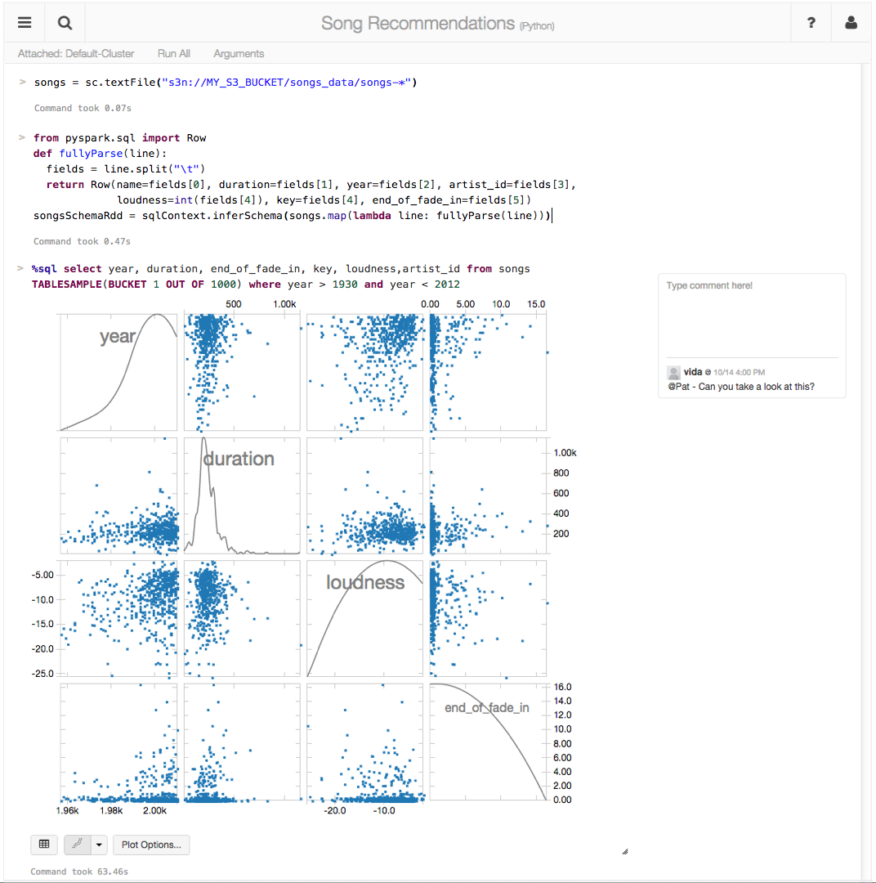
making big data simple
Founded in late 2013
by the creators of Apache Spark
Original team from UC Berkeley AMPLab
Raised $47 Million in 2 rounds
~300 employees
Databricks Cloud:
“A unified platform for building Big Data pipelines – from ETL to Exploration and Dashboards, to Advanced Analytics and Data Products.”
Notes:
Databricks is a company that was founded by the creators of the Spark project in 2013.
And one of the first things the founders did after starting the company was donating Spark to the Apache Software Foundation and they remain the largest contributor to Spark’s code base.
Databricks Cloud is a end-to-end hosted service. The goal of our product is to be the easiest place to be up and running with Spark with little or no up-front hardware or cost investment, since it’s a cloud service. We want to help our customers quickly pull out insights via visualization from your data… without worrying about the intricacies of installing and configuring large Hadoop cluster.

Slide 4
The Databricks team contributed more than 75% of the code added to Spark in the past year
Notes:
The point: Adopting Spark is relatively safe, since it's being maintained by people who are paid to do so.

Slide 5
Started as a research project at UC Berkeley in 2009
Open Source License (Apache 2.0)
Latest Stable Release: v2.3.0 (28 Feb 2018)
1,000,000 lines of code (85% Scala)
Built by 800+ developers from 200+ companies

Slide 6




0.1 Gb/s
1 Gb/s or 125 MB/s
Nodes in another rack
CPUs:
Network
10 GB/s
1 Gb/s or 125 MB/s
Nodes in same rack
100 MB/s
600 MB/s
3-12 ms random access
$0.05 per GB
0.1 ms random access
$0.45 per GB

Slide 7

Opportunity
Keep more data in-memory
New distributed execution environment
Bindings for:
Python, Java, Scala, R
Spark SQL
ML/MLLib (machine learning)
GraphX (graph)
Spark Streaming
Apache Spark
http://people.csail.mit.edu/matei/papers/2010/hotcloud_spark.pdf

Slide 8

In-Memory Data Sharing
HDFS read
iteration 1
iteration 2
. . .
Input
query 1
result 1
one-time
processing
query 2
result 2
query 3
result 3
Input
Distributed memory
. . .
10-100x faster than network and disk

Slide 9
Goal: unified engine across sources data workloads and environments
Environments
Workloads
Data Sources
Notes:
To-do: build with animations

Slide 10


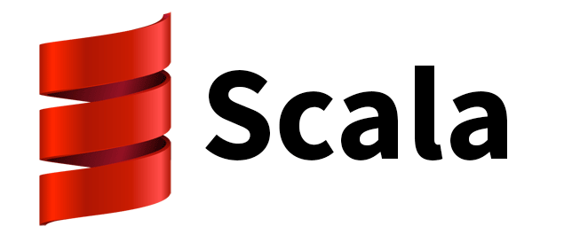
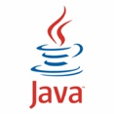













Environments
YARN
Workloads
DataFrames API and Spark SQL
Spark Streaming
MLlib
GraphX
RDD API
Spark Core
{JSON}
Data Sources
Notes:
TO-DO: Add: Environments: OpenStack, Kubernetes. Add Kafka to Data Sources.
Say: Most new code activity is in the higher level libraries. Spark SQL and MLlib’s code base has doubled in the past year.
“for relational databases, there is a JDBC + ODBC connector”
To-do, 2nd iteration + book: Add new rectangle for ‘Notebooks’: Jupiter, Databricks, iPython, Zeplin, etc

Slide 11
RDD Fundamentals

Slide 12
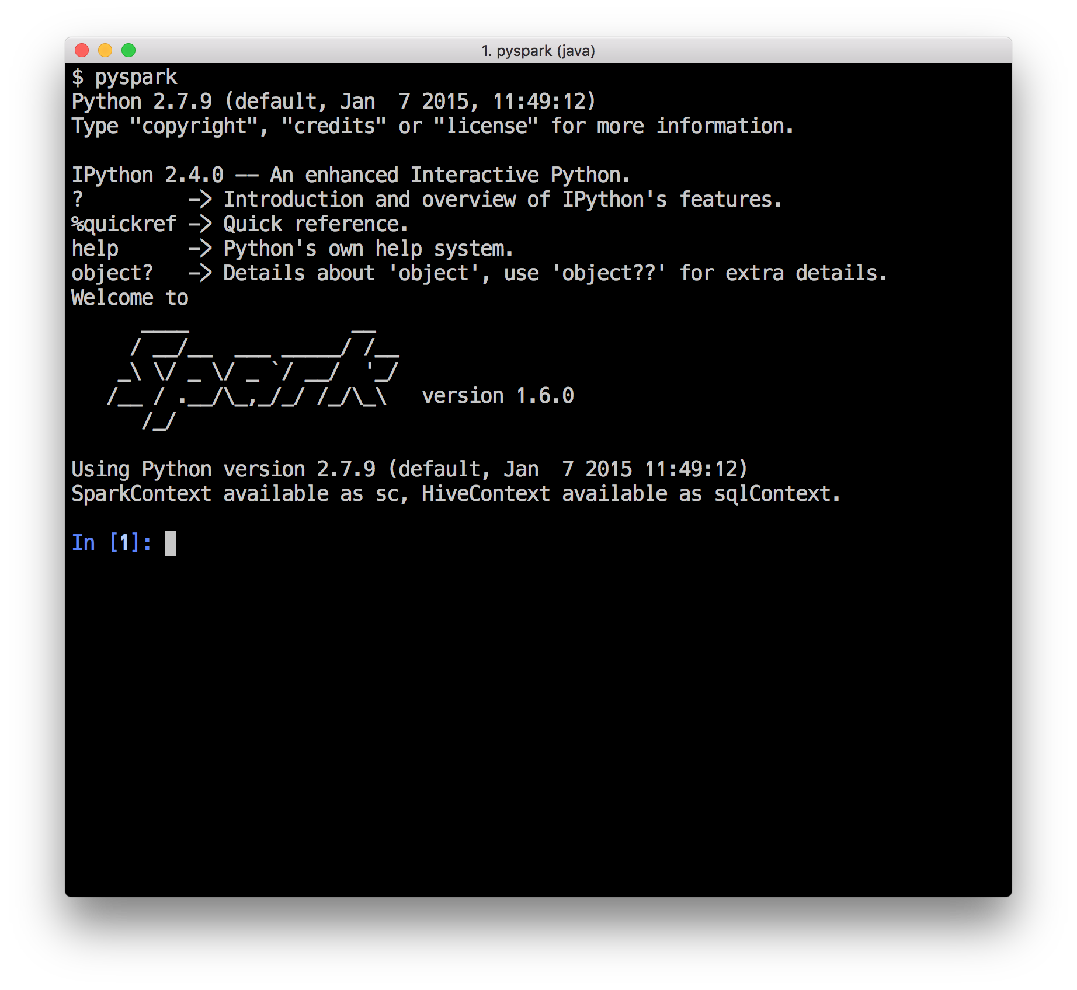
Interactive Shell
(Scala, Python and R only)

Slide 13
W
Ex
RDD
T
Driver Program
RDD
T
Worker Machine
W
Ex
RDD
T
RDD
T
Worker Machine
Notes:
When you start a driver program, it connects to the Spark Cluster
You can make the Driver HA in standalone by setting the Boolean for –supervise to true when using Spark Submit (https://github.com/apache/spark/search?utf8=%E2%9C%93&q=supervise)
In YARN the driver is HA via YARN primitives

Slide 14
Resilient Distributed Datasets (RDDs)
Write programs in terms of operations on distributed datasets
Partitioned collections of objects spread across a cluster, stored in memory or on disk
RDDs built and manipulated through a diverse set of parallel transformations (map, filter, join) and actions (count, collect, save)
RDDs automatically rebuilt on machine failure
Notes:
Program in tterms of ops
Partitioned
Transformations
Resilient (rebuilt)

Slide 15
more partitions = more parallelism
RDD
item-1
item-2
item-3
item-4
item-5
item-6
item-7
item-8
item-9
item-10
item-11
item-12
item-13
item-14
item-15
item-16
item-17
item-18
item-19
item-20
item-21
item-22
item-23
item-24
item-25
W
W
W
Ex
Ex
Ex
RDD
RDD
RDD
RDD
RDD
Notes:
This RDD has 5 partitions.
An RDD is simply a distributed collection of elements. You can think of the distributed collections like of like an array or list in your single machine program, except that it’s spread out across multiple nodes in the cluster.
In Spark all work is expressed as either creating new RDDs, transforming existing RDDs, or calling operations on RDDs to compute a result. Under the hood, Spark automatically distributes the data contained in RDDs across your cluster and parallelizes the operations you perform on them.
So, Spark gives you APIs and functions that lets you do something on the whole collection in parallel using all the nodes.

Slide 16
RDD w/ 4 partitions
Error, ts, msg1
Warn, ts, msg2
Error, ts, msg1
Info, ts, msg8
Warn, ts, msg2
Info, ts, msg8
Error, ts, msg3
Info, ts, msg5
Info, ts, msg5
Error, ts, msg4
Warn, ts, msg9
Error, ts, msg1
logLinesRDD
A base RDD can be created 2 ways:
- Parallelize a collection
- Read data from an external source (S3, C*, HDFS, etc)

Slide 17


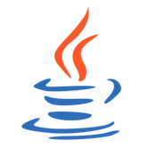
Parallelize
// Parallelize in Scala
val wordsRDD = sc.parallelize(List("fish", "cats", "dogs"))
Take an existing in-memory collection and pass it to SparkContext’s parallelize method
Not generally used outside of prototyping and testing since it requires entire dataset in memory on one machine
# Parallelize in Python
wordsRDD = sc.parallelize(["fish", "cats", "dogs"])
// Parallelize in Java
JavaRDD<String> wordsRDD = sc.parallelize(Arrays.asList("fish", "cats", "dogs"));
Notes:
In some edge cases this could be useful … e.g., parallelize and partition a set of URLs or metadata, then fetch the actual data on the workers

Slide 18
Read from Text File
There are other methods to read data from HDFS, C*, S3, HBase, etc.
// Read a local txt file in Scala
val linesRDD = sc.textFile("/path/to/README.md")
# Read a local txt file in Python
linesRDD = sc.textFile("/path/to/README.md")
// Read a local txt file in Java
JavaRDD<String> lines = sc.textFile("/path/to/README.md");

Slide 19
Operations on Distributed Data
Two types of operations: transformations and actions
Transformations are lazy (not computed immediately)
Transformations are executed when an action is run
Persist (cache) distributed data in memory or disk

Slide 20



Error, ts, msg1
Warn, ts, msg2
Error, ts, msg1
Info, ts, msg8
Warn, ts, msg2
Info, ts, msg8
Error, ts, msg3
Info, ts, msg5
Info, ts, msg5
Error, ts, msg4
Warn, ts, msg9
Error, ts, msg1
logLinesRDD
(input/base RDD)
λ
.filter( )
Error, ts, msg1
Error, ts, msg1
Error, ts, msg3
Error, ts, msg4
Error, ts, msg1
errorsRDD
Notes:
Those are 4 green unique blocks in a single HDFS file
Here we are filtering out the warnings and info messages so we are left with just errors in the RDD.
This doesn’t actually read the file from HDFS just yet… we’re just building out a lineage graph
Initial partition generally determined by SOURCE, which is also aware of location info (e.g., HDFS blocks) and can provide that downstream (via preferredLocations)

Slide 21

Error, ts, msg1
Error, ts, msg1
Error, ts, msg3
Error, ts, msg4
Error, ts, msg1
errorsRDD
.coalesce( 2 )
Error, ts, msg1
Error, ts, msg3
Error, ts, msg1
Error, ts, msg4
Error, ts, msg1
cleanedRDD
.collect( )
Driver

Slide 22
Execute DAG!
.collect( )
Driver
Notes:
The Batman slide

Slide 23

Logical
logLinesRDD
λ
.filter( )
errorsRDD
.coalesce( 2 )
cleanedRDD
.collect( )
Driver

Slide 24
Physical
4. compute
logLinesRDD
3. compute
errorsRDD
2. compute
cleanedRDD
1. compute
Driver

Slide 25
data
data
Driver

Slide 26

logLinesRDD
errorsRDD
.saveAsTextFile( )
Error, ts, msg1
Error, ts, msg3
Error, ts, msg1
Error, ts, msg4
Error, ts, msg1
cleanedRDD
λ
.filter( )
Error, ts, msg1
Error, ts, msg1
Error, ts, msg1
.count( )
5
errorMsg1RDD
.collect( )
Notes:
What if we want to do other things, multiple things, with the cleaned RDD? …

Slide 27


logLinesRDD
errorsRDD
.cache( )
.saveAsTextFile( )
Error, ts, msg1
Error, ts, msg3
Error, ts, msg1
Error, ts, msg4
Error, ts, msg1
cleanedRDD
λ
.filter( )
Error, ts, msg1
Error, ts, msg1
Error, ts, msg1
.count( )
5
errorMsg1RDD
.collect( )
Notes:
It’s okay if only part of the RDD actually fits in memory
Talk about lineage: parent RDD and child RDD

Slide 28

Partition >>> Task >>> Partition
logLinesRDD
(HadoopRDD)
Task-1
Task-2
λ
Task-3
.filter( )
Task-4
errorsRDD
(filteredRDD)
Notes:
This is a narrow transformation…
1 Task <-> 1 Partition, and usually <-> 1 Core (although this can be configured higher)
How many executors? Depends on cluster config. I.e., these 1:1 mappings are NOT 1:1 with executors

Slide 29
Lifecycle of a Spark Program
Create some input RDDs from external data or parallelize a collection in your driver program.
Lazily transform them to define new RDDs using transformations like filter() or map()
Ask Spark to cache() any intermediate RDDs that will need to be reused.
Launch actions such as count() and collect() to kick off a parallel computation, which is then optimized and executed by Spark.

Slide 30
Transformations (lazy)
map() | intersection() | cartesian()
flatMap() | distinct() | pipe()
filter() | groupByKey() | coalesce()
mapPartitions() | reduceByKey() | repartition()
mapPartitionsWithIndex() | sortByKey() | partitionBy()
sample() | join() | ...
union() | cogroup() | ...

Slide 31
Actions
reduce() | takeOrdered()
collect() | saveAsTextFile()
count() | saveAsSequenceFile()
first() | saveAsObjectFile()
take() | countByKey()
takeSample() | foreach()
saveToCassandra() | ...
Notes:
Actions force the evaluation of the transformations required for the RDD they are called on, since they are required to actually produce output.

Slide 32
Some Types of RDDs
HadoopRDD
FilteredRDD
MappedRDD
PairRDD
ShuffledRDD
UnionRDD
PythonRDD
DoubleRDD
JdbcRDD
JsonRDD
VertexRDD
EdgeRDD
CassandraRDD (DataStax)
GeoRDD (ESRI)
EsSpark (ElasticSearch)
Notes:
SWITCH TO VISUAL GUIDE.
There are various types of RDDs, and you can write your own.

Slide 33
Visual Guide to Transformations

Slide 34


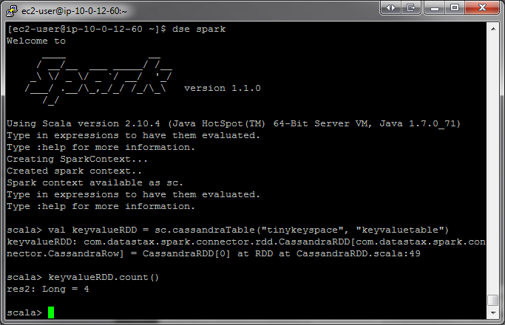

RDD
RDD Elements
Legend
key
original item
B
transformed type
partition(s)
A
object on driver
user input
user functions
emitted value
input

Slide 35



vs
narrow
wide
each partition of the parent RDD is used by at most one partition of the child RDD
multiple child RDD partitions may depend on a single parent RDD partition

Slide 36
narrow
wide
each partition of the parent RDD is used by at most one partition of the child RDD
multiple child RDD partitions may depend on a single parent RDD partition
groupByKey
map, filter
union
join w/ inputs
co-partitioned
join w/ inputs not
co-partitioned

Slide 37
map
RDD: x
3 items in RDD
(partitions not shown)

Slide 38
map
RDD: x
RDD: y
User function applied item by item

Slide 39
map
RDD: x
RDD: y

Slide 40
map
RDD: x
RDD: y

Slide 41
map
After map() has been applied…
RDD: x
RDD: y
before
after

Slide 42


map
RDD: x
RDD: y
Return a new RDD by applying a function to each element of this RDD.

Slide 43


map
RDD: x
RDD: y
map(f, preservesPartitioning=False)
Return a new RDD by applying a function to each element of this RDD
x = sc.parallelize([1, 2, 3])
y = x.map(lambda z: z * z)
print(x.collect())
print(y.collect())
x:
[1, 2, 3]
[1, 4, 9]
y:
val x = sc.parallelize(Array(1, 2, 3))
val y = x.map(z => z * z)
println(x.collect().mkString(", "))
println(y.collect().mkString(", "))

Slide 44
filter
RDD: x
3 items in RDD
(partitions not shown)

Slide 45
filter
RDD: x
RDD: y
Apply user function: keep item if function returns true
True
emits

Slide 46
filter
RDD: x
RDD: y
False
emits

Slide 47
filter
RDD: x
RDD: y
True
emits

Slide 48
filter
After filter() has been applied…
RDD: x
RDD: y
before
after

Slide 49
filter
RDD: x
RDD: y
filter(f)
Return a new RDD containing only the elements that satisfy a predicate
x = sc.parallelize([1,2,3])
y = x.filter(lambda x: x%2 == 1) #keep odd values
print(x.collect())
print(y.collect())
x:
[1, 2, 3]
[1, 3]
y:
val x = sc.parallelize(Array(1,2,3))
val y = x.filter(n => n%2 == 1)
println(x.collect().mkString(", "))
println(y.collect().mkString(", "))

Slide 50
flatmap
RDD: x
3 items in RDD
(partitions not shown)

Slide 51
flatmap
RDD: x
RDD: y

Slide 52
flatmap
RDD: x
RDD: y

Slide 53
flatmap
RDD: x
RDD: y

Slide 54
flatmap
After flatmap() has been applied…
RDD: x
RDD: y
before
after

Slide 55
flatmap
RDD: x
RDD: y
Return a new RDD by first applying a function to all elements of this RDD, and then flattening the results

Slide 56
Flatmap
RDD: x
RDD: y
flatMap(f, preservesPartitioning=False)
Return a new RDD by first applying a function to all elements of this RDD, and then flattening the results
x = sc.parallelize([1,2,3])
y = x.flatMap(lambda x: (x, x*100, 42))
print(x.collect())
print(y.collect())
x:
[1, 2, 3]
[1, 100, 42, 2, 200, 42, 3, 300, 42]
y:
val x = sc.parallelize(Array(1,2,3))
val y = x.flatMap(n => Array(n, n*100, 42))
println(x.collect().mkString(", "))
println(y.collect().mkString(", "))

Slide 57
groupBy
RDD: x
4 items in RDD
James
Anna
Fred
John
(partitions not shown)

Slide 58
groupBy
RDD: x
RDD: y
James
Anna
Fred
John
J
[ “John” ]
‘J’
emits

Slide 59
groupBy
RDD: x
RDD: y
James
Anna
Fred
F
[ “Fred” ]
John
J
[ “John” ]
‘F’
emits

Slide 60
groupBy
RDD: x
RDD: y
James
A
[ “Anna” ]
Anna
Fred
F
[ “Fred” ]
‘A’
John
J
[ “John” ]
emits

Slide 61
groupBy
RDD: x
RDD: y
James
A
[ “Anna” ]
Anna
Fred
F
[ “Fred” ]
‘J’
emits
John
J
[ “John”, “James” ]

Slide 62
groupBy
RDD: x
RDD: y
groupBy(f, numPartitions=None)
Group the data in the original RDD. Create pairs where the key is the output of a user function, and the value is all items for which the function yields this key.
x = sc.parallelize(['John', 'Fred', 'Anna', 'James'])
y = x.groupBy(lambda w: w[0])
print [(k, list(v)) for (k, v) in y.collect()]
x:
['John', 'Fred', 'Anna', 'James']
[('A',['Anna']),('J',['John','James']),('F',['Fred'])]
y:
val x = sc.parallelize(
Array("John", "Fred", "Anna", "James"))
val y = x.groupBy(w => w.charAt(0))
println(y.collect().mkString(", "))

Slide 63
groupByKey
Pair RDD: x
5 items in RDD
B
5
B
4
A
3
A
2
A
1
(partitions not shown)

Slide 64
groupByKey
Pair RDD: x
RDD: y
B
5
B
4
A
3
A
2
A
1
A
[ 2 , 3 , 1 ]

Slide 65
groupByKey
Pair RDD: x
RDD: y
B
5
B
4
A
3
B
[ 5 , 4 ]
A
2
A
1
A
[ 2 , 3 , 1 ]

Slide 66
groupByKey
RDD: x
RDD: y
groupByKey(numPartitions=None)
Group the values for each key in the original RDD. Create a new pair where the original key corresponds to this collected group of values.
x = sc.parallelize([('B',5),('B',4),('A',3),('A',2),('A',1)])
y = x.groupByKey()
print(x.collect())
print(list((j[0], list(j[1])) for j in y.collect()))
x:
[('B', 5),('B', 4),('A', 3),('A', 2),('A', 1)] [('A', [2, 3, 1]),('B',[5, 4])]
y:
val x = sc.parallelize( Array(('B',5),('B',4),('A',3),('A',2),('A',1)))
val y = x.groupByKey()
println(x.collect().mkString(", "))
println(y.collect().mkString(", "))

Slide 67
ReduceByKey vs GroupByKey
val words = Array("one", "two", "two", "three", "three", "three")
val wordPairsRDD = sc.parallelize(words).map(word => (word, 1))
val wordCountsWithReduce = wordPairsRDD
.reduceByKey(_ + _)
.collect()
val wordCountsWithGroup = wordPairsRDD
.groupByKey()
.map(t => (t._1, t._2.sum))
.collect()

Slide 68
ReduceByKey
(a, 1)
(a, 1)
(a, 1)
(a, 1)
(a, 1)
(b, 1)
(a, 1)
(b, 1)
(b, 1)
(b, 1)
(b, 1)

Slide 69
ReduceByKey
(a, 1)
(a, 1)
(a, 1)
(a, 1)
(a, 1)
(a, 1)
(a, 2)
(a, 3)
(b, 1)
(b, 1)
(a, 1)
(b, 1)
(b, 2)
(b, 2)
(b, 1)
(b, 1)
(b, 1)

Slide 70
ReduceByKey
(a, 1)
(a, 1)
(a, 1)
(a, 1)
(a, 1)
(a, 1)
(a, 2)
(a, 3)
(b, 1)
(b, 1)
(a, 1)
(b, 1)
(b, 2)
(b, 2)
(b, 1)
(b, 1)
(b, 1)
a
b
(a, 1)
(b, 1)
(a, 2)
(b, 2)
(a, 3)
(b, 2)

Slide 71
ReduceByKey
(a, 1)
(a, 1)
(a, 1)
(a, 1)
(a, 1)
(a, 1)
(a, 2)
(a, 3)
(b, 1)
(b, 1)
(a, 1)
(b, 1)
(b, 2)
(b, 2)
(b, 1)
(b, 1)
(b, 1)
a
b
(a, 1)
(b, 1)
(a, 2)
(a, 6)
(b, 2)
(b, 5)
(a, 3)
(b, 2)

Slide 72
GroupByKey
(a, 1)
(a, 1)
(a, 1)
(a, 1)
(a, 1)
(b, 1)
(a, 1)
(b, 1)
(b, 1)
(b, 1)
(b, 1)

Slide 73
GroupByKey
(a, 1)
(a, 1)
(a, 1)
(a, 1)
(a, 1)
(b, 1)
(a, 1)
(b, 1)
(b, 1)
(b, 1)
(b, 1)
a
b
(a, 1)
(a, 1)
(b, 1)
(a, 1)
(b, 1)
(a, 1)
(b, 1)
(a, 1)
(b, 1)
(a, 1)
(b, 1)

Slide 74
GroupByKey
(a, 1)
(a, 1)
(a, 1)
(a, 1)
(a, 1)
(b, 1)
(a, 1)
(b, 1)
(b, 1)
(b, 1)
(b, 1)
a
b
(a, 1)
(a, 1)
(b, 1)
(a, 1)
(b, 1)
(a, 1)
(a, 6)
(b, 1)
(b, 5)
(a, 1)
(b, 1)
(a, 1)
(b, 1)

Slide 75
mapPartitions
RDD: x
RDD: y
B
partitions
B
A
A

Slide 76
mapPartitions
B
B
A
A
mapPartitions(f, preservesPartitioning=False)
Return a new RDD by applying a function to each partition of this RDD
val x = sc.parallelize(Array(1,2,3), 2)
def f(i:Iterator[Int])={ (i.sum,42).productIterator }
val y = x.mapPartitions(f)
// glom() flattens elements on the same partition
val xOut = x.glom().collect()
val yOut = y.glom().collect()
x:
Array(Array(1), Array(2, 3))
Array(Array(1, 42), Array(5, 42))
y:
Notes:
Sum of everything in partition, 42

Slide 77
mapPartitions
B
B
A
A
mapPartitions(f, preservesPartitioning=False)
Return a new RDD by applying a function to each partition of this RDD
x = sc.parallelize([1,2,3], 2)
def f(iterator): yield sum(iterator); yield 42
y = x.mapPartitions(f)
# glom() flattens elements on the same partition
print(x.glom().collect())
print(y.glom().collect())
x:
[[1], [2, 3]]
[[1, 42], [5, 42]]
y:

Slide 78

sample
RDD: x
RDD: y
5
4
3
1
2
1
3
Notes:
To-do: swap

Slide 79
sample
RDD: x
RDD: y
sample(withReplacement, fraction, seed=None)
Return a new RDD containing a statistical sample of the original RDD
x = sc.parallelize([1, 2, 3, 4, 5])
y = x.sample(False, 0.4, 42)
print(x.collect())
print(y.collect())
x:
[1, 2, 3, 4, 5] [1, 3]
val x = sc.parallelize(Array(1, 2, 3, 4, 5))
val y = x.sample(false, 0.4)
// omitting seed will yield different output
println(y.collect().mkString(", "))
y:

Slide 80
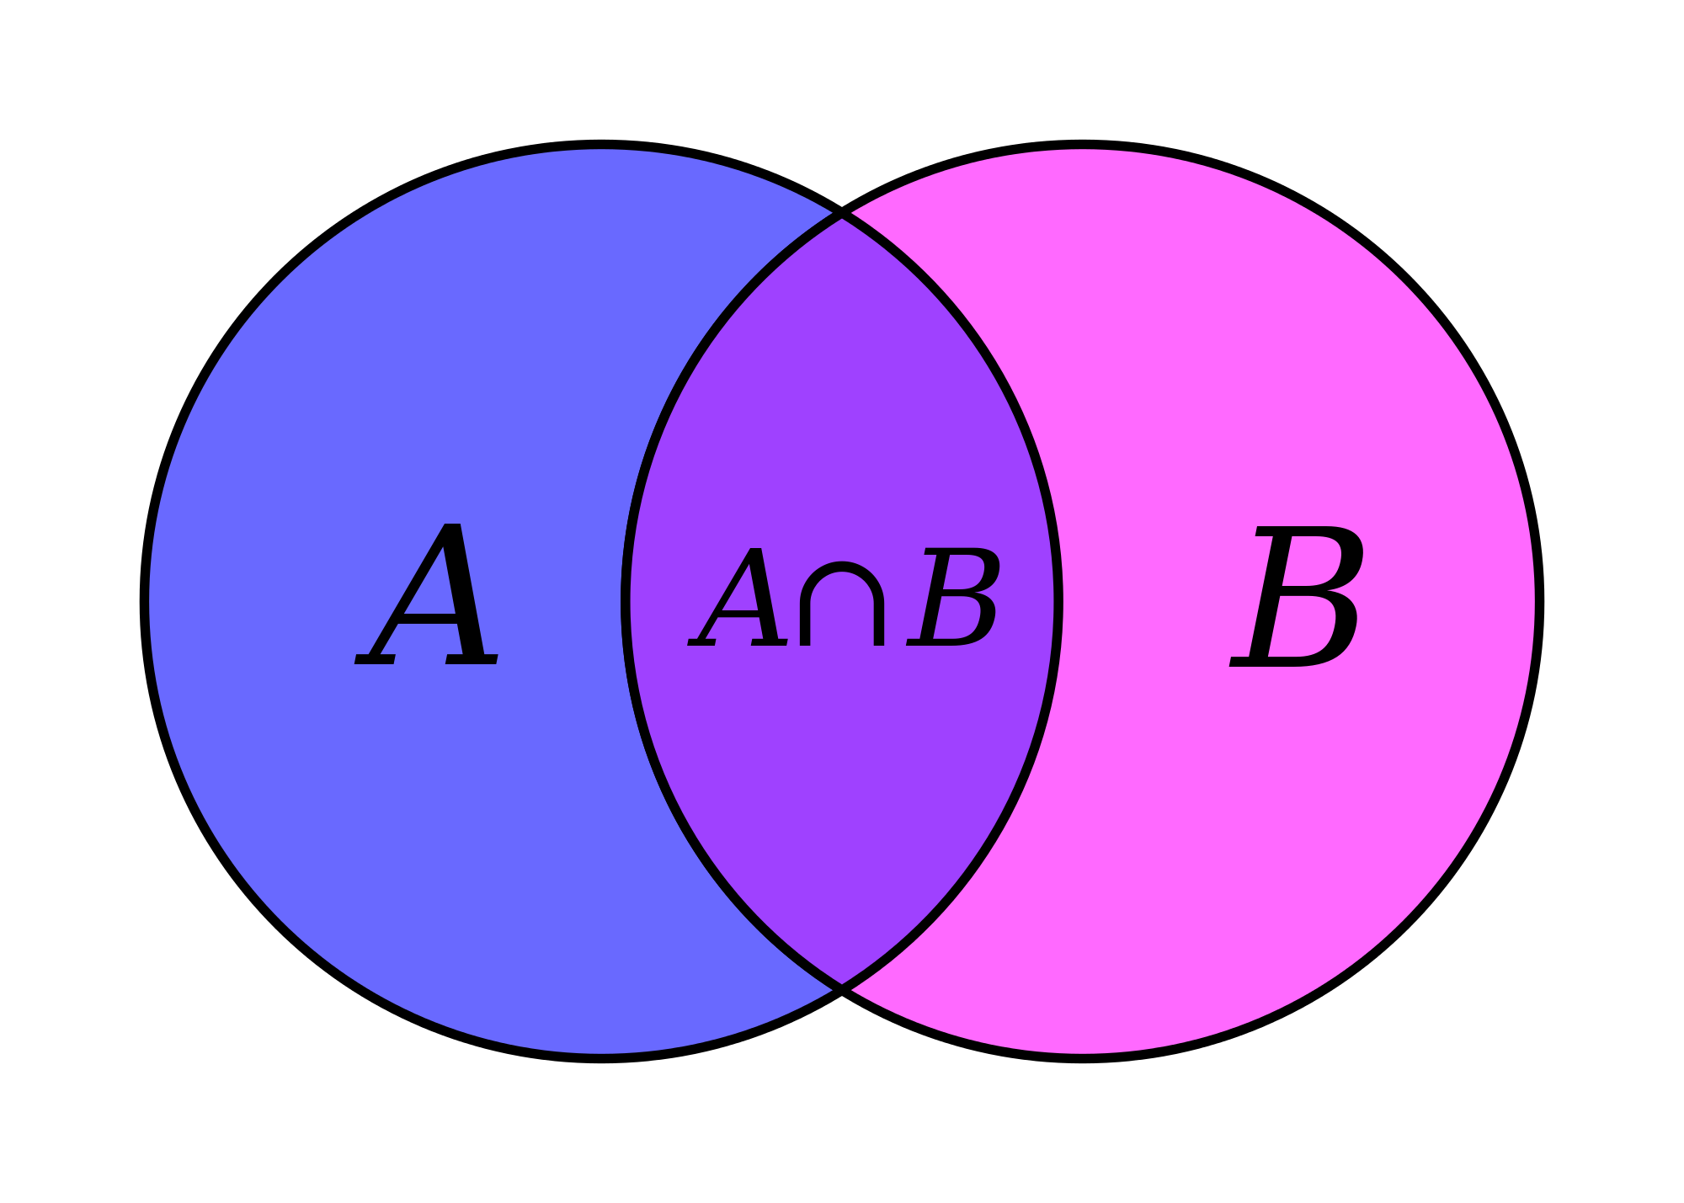
union
RDD: x
RDD: y
3
4
2
3
1
B
C
A
4
RDD: z
3
3
2
C
1
B
A

Slide 81
union
Return a new RDD containing all items from two original RDDs. Duplicates are not culled.
union(otherRDD)
x = sc.parallelize([1,2,3], 2)
y = sc.parallelize([3,4], 1)
z = x.union(y)
print(z.glom().collect())
x:
[1, 2, 3] [3, 4]
[[1], [2, 3], [3, 4]]
y:
val x = sc.parallelize(Array(1,2,3), 2)
val y = sc.parallelize(Array(3,4), 1)
val z = x.union(y)
val zOut = z.glom().collect()
z:

Slide 82
join
RDD: x
RDD: y
B
5
B
2
A
4
A
1
A
3
Notes:
To-do: swap

Slide 83
join
RDD: x
RDD: y
B
5
B
2
A
4
A
1
A
3
RDD: z
A
(1, 3)
Notes:
To-do: swap

Slide 84
join
RDD: x
RDD: y
B
5
B
2
A
4
A
1
A
3
RDD: z
A
(1, 4)
A
(1, 3)
Notes:
To-do: swap

Slide 85
join
RDD: x
RDD: y
B
5
B
2
A
4
A
1
A
3
B
(2, 5)
RDD: z
A
(1, 4)
A
(1, 3)
Notes:
To-do: swap

Slide 86
join
Return a new RDD containing all pairs of elements having the same key in the original RDDs
join(otherRDD, numPartitions=None)
x = sc.parallelize([("a", 1), ("b", 2)])
y = sc.parallelize([("a", 3), ("a", 4), ("b", 5)])
z = x.join(y)
print(z.collect())
x:
[("a", 1), ("b", 2)]
[("a", 3), ("a", 4), ("b", 5)]
[('a', (1, 3)), ('a', (1, 4)), ('b', (2, 5))]
y:
z:
val x = sc.parallelize(Array(("a", 1), ("b", 2)))
val y = sc.parallelize(Array(("a", 3), ("a", 4), ("b", 5)))
val z = x.join(y)
println(z.collect().mkString(", "))

Slide 87
distinct
RDD: x
4
3
3
2
1

Slide 88
distinct
RDD: x
RDD: y
4
4
3
3
3
3
2
2
1
1

Slide 89
distinct
RDD: x
RDD: y
4
4
3
3
3
2
2
1
1

Slide 90
distinct
*
¤
*
*
¤
Return a new RDD containing distinct items from the original RDD (omitting all duplicates)
distinct(numPartitions=None)
x = sc.parallelize([1,2,3,3,4])
y = x.distinct()
print(y.collect())
x:
[1, 2, 3, 3, 4]
[1, 2, 3, 4]
y:
val x = sc.parallelize(Array(1,2,3,3,4))
val y = x.distinct()
println(y.collect().mkString(", "))

Slide 91
coalesce
RDD: x
C
B
A

Slide 92
coalesce
RDD: x
RDD: y
C
B
A
AB

Slide 93
coalesce
RDD: x
RDD: y
C
C
B
A
AB

Slide 94
coalesce
C
C
B
AB
A
Return a new RDD which is reduced to a smaller number of partitions
coalesce(numPartitions, shuffle=False)
x = sc.parallelize([1, 2, 3, 4, 5], 3)
y = x.coalesce(2)
print(x.glom().collect())
print(y.glom().collect())
x:
[[1], [2, 3], [4, 5]]
[[1], [2, 3, 4, 5]]
y:
val x = sc.parallelize(Array(1, 2, 3, 4, 5), 3)
val y = x.coalesce(2)
val xOut = x.glom().collect()
val yOut = y.glom().collect()

Slide 95
keyBy
RDD: x
RDD: y
James
Anna
Fred
John
J
“John”
‘J’
emits

Slide 96
keyBy
RDD: x
RDD: y
James
Anna
Fred
F
“Fred”
John
J
“John”
‘F’

Slide 97
keyBy
RDD: x
RDD: y
James
Anna
A
“Anna”
Fred
F
“Fred”
‘A’
John
J
“John”

Slide 98
keyBy
RDD: x
RDD: y
James
J
“James”
Anna
A
“Anna”
‘J’
Fred
F
“Fred”
emits
John
J
“John”

Slide 99
keyBy
RDD: x
RDD: y
keyBy(f)
Create a Pair RDD, forming one pair for each item in the original RDD. The pair’s key is calculated from the value via a user-supplied function.
x = sc.parallelize(['John', 'Fred', 'Anna', 'James'])
y = x.keyBy(lambda w: w[0])
print y.collect()
x:
['John', 'Fred', 'Anna', 'James']
[('J','John'),('F','Fred'),('A','Anna'),('J','James')]
y:
val x = sc.parallelize(
Array("John", "Fred", "Anna", "James"))
val y = x.keyBy(w => w.charAt(0))
println(y.collect().mkString(", "))

Slide 100
zip
RDD: x
RDD: y
3
9
2
4
1
1
B
B
A
A
Notes:
To-do: swap

Slide 101
zip
RDD: x
RDD: y
3
9
2
4
1
1
B
B
A
A
4
RDD: z
1
1
A
Notes:
To-do: swap

Slide 102
zip
RDD: x
RDD: y
3
9
2
4
1
1
B
B
A
A
4
RDD: z
2
4
1
1
A
Notes:
To-do: swap

Slide 103
zip
RDD: x
RDD: y
3
9
2
4
1
1
B
B
A
A
4
RDD: z
3
9
2
4
1
1
B
A
Notes:
To-do: swap

Slide 104
zip
Return a new RDD containing pairs whose key is the item in the original RDD, and whose value is that item’s corresponding element (same partition, same index) in a second RDD
zip(otherRDD)
x = sc.parallelize([1, 2, 3])
y = x.map(lambda n:n*n)
z = x.zip(y)
print(z.collect())
x:
[1, 2, 3] [1, 4, 9]
[(1, 1), (2, 4), (3, 9)]
y:
val x = sc.parallelize(Array(1,2,3))
val y = x.map(n=>n*n)
val z = x.zip(y)
println(z.collect().mkString(", "))
z:

Slide 105
Actions

Slide 106


vs
distributed
driver
occurs across the cluster
result must fit in driver JVM

Slide 107
getNumPartitions
2
B
partition(s)
A

Slide 108
2
getNumPartitions
B
A
getNumPartitions()
Return the number of partitions in RDD
x = sc.parallelize([1,2,3], 2)
y = x.getNumPartitions()
print(x.glom().collect())
print(y)
x:
[[1], [2, 3]]
2
val x = sc.parallelize(Array(1,2,3), 2)
val y = x.partitions.size
val xOut = x.glom().collect()
println(y)
y:

Slide 109
collect
[ ]
B
partition(s)
A

Slide 110
collect
[ ]
B
A
collect()
Return all items in the RDD to the driver in a single list
x = sc.parallelize([1,2,3], 2)
y = x.collect()
print(x.glom().collect())
print(y)
x:
[[1], [2, 3]]
[1, 2, 3]
val x = sc.parallelize(Array(1,2,3), 2)
val y = x.collect()
val xOut = x.glom().collect()
println(y)
y:

Slide 111
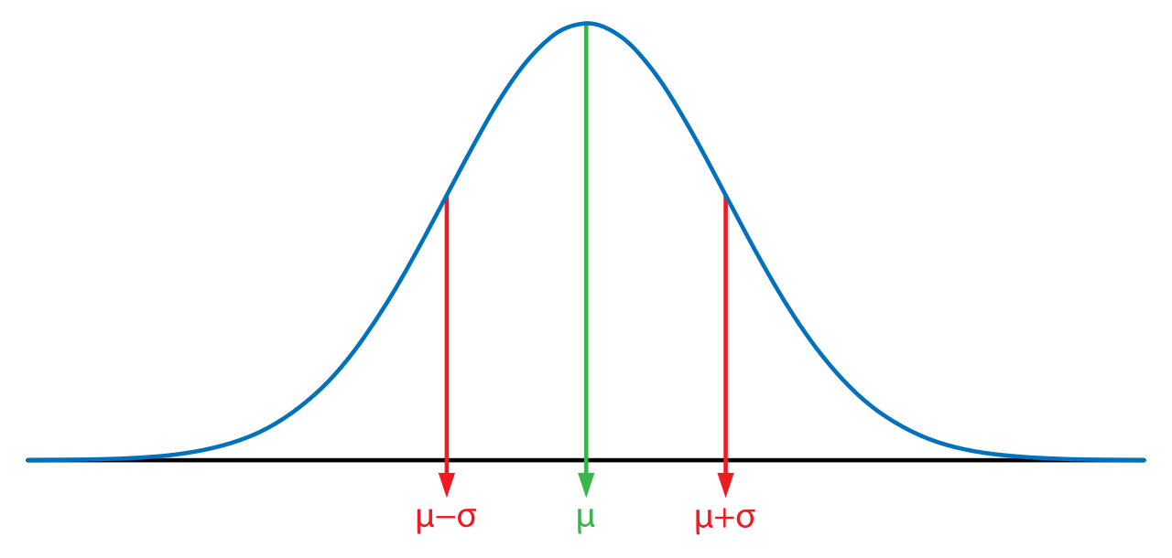
max
1
4
4
2

Slide 112
max
1
4
4
max
2
max()
Return the maximum item in the RDD
x = sc.parallelize([2,4,1])
y = x.max()
print(x.collect())
print(y)
x:
[2, 4, 1]
4
val x = sc.parallelize(Array(2,4,1))
val y = x.max
println(x.collect().mkString(", "))
println(y)
y:

Slide 113
sum
1
4
7
2

Slide 114
Σ
1
4
7
sum
2
sum()
Return the sum of the items in the RDD
x = sc.parallelize([2,4,1])
y = x.sum()
print(x.collect())
print(y)
x:
[2, 4, 1]
7
val x = sc.parallelize(Array(2,4,1))
val y = x.sum
println(x.collect().mkString(", "))
println(y)
y:

Slide 115
mean
1
4
2.33333333
2

Slide 116
x
1
4
2.3333333
mean
2
mean()
Return the mean of the items in the RDD
x = sc.parallelize([2,4,1])
y = x.mean()
print(x.collect())
print(y)
x:
[2, 4, 1]
2.3333333
val x = sc.parallelize(Array(2,4,1))
val y = x.mean
println(x.collect().mkString(", "))
println(y)
y:

Slide 117
stdev
1
4
1.2472191
2

Slide 118
σ
1
4
1.2472191
stdev
2
stdev()
Return the standard deviation of the items in the RDD
x = sc.parallelize([2,4,1])
y = x.stdev()
print(x.collect())
print(y)
x:
[2, 4, 1]
1.2472191
val x = sc.parallelize(Array(2,4,1))
val y = x.stdev
println(x.collect().mkString(", "))
println(y)
y:

Slide 119

saveAsTextFile

Slide 120
saveastextFile
saveAsTextFile(path, compressionCodecClass=None)
Save the RDD to the filesystem indicated in the path
dbutils.fs.rm("/temp/demo", True)
x = sc.parallelize([2,4,1])
x.saveAsTextFile("/temp/demo")
y = sc.textFile("/temp/demo")
print(y.collect())
x:
[2, 4, 1]
[u'2', u'4', u'1']
dbutils.fs.rm("/temp/demo", true)
val x = sc.parallelize(Array(2,4,1))
x.saveAsTextFile("/temp/demo")
val y = sc.textFile("/temp/demo")
println(y.collect().mkString(", "))
y:

Slide 121
DataFrames & Spark SQL

Slide 122
Spark SQL
Part of the core distribution since 1.0 (April 2014)
Runs SQL / HiveQL queries, optionally alongside or replacing existing Hive deployments
Improved multi-version support in 1.4

Slide 123
DataFrames API
Enable wider audiences beyond “Big Data” engineers to leverage the power of distributed processing
Inspired by data frames in R and Python (Pandas)
Designed from the ground-up to support modern big data and data science applications
Extension to the existing RDD API

Slide 124
DataFrames
The preferred abstraction in Spark
Strongly typed collection of distributed elements
Built on Resilient Distributed Datasets
Immutable once constructed
Track lineage information to efficiently re-compute lost data
Enable operations on collection of elements in parallel
You construct DataFrames
by parallelizing existing collections (e.g., Pandas DataFrames)
by transforming an existing DataFrames
from files in HDFS or any other storage system (e.g., Parquet)

Slide 125
DataFrames Features
Ability to scale from kilobytes of data on a single laptop to petabytes on a large cluster
Support for a wide array of data formats and storage systems
State-of-the-art optimization and code generation through the Spark SQL Catalyst optimizer
Seamless integration with all big data tooling and infrastructure via Spark
APIs for Python, Java, Scala, and R

Slide 126
DataFrames versus RDDs
For new users familiar with data frames in other programming languages, this API should make them feel at home
For existing Spark users, the API will make Spark easier to program than using RDDs
For both sets of users, DataFrames will improve performance through intelligent optimizations and code-generation

Slide 127

Write Less Code: Input & Output
Unified interface to reading/writing data in a variety of formats.
val df = sqlContext. read. format("json").
option("samplingRatio", "0.1").
load("/Users/spark/data/stuff.json")
df.write.
format("parquet").
mode("append").
partitionBy("year").
saveAsTable("faster-stuff")

Slide 128
Write Less Code: Input & Output
Unified interface to reading/writing data in a variety of formats.
val df = sqlContext. read. format("json").
option("samplingRatio", "0.1").
load("/Users/spark/data/stuff.json")
df.write.
format("parquet").
mode("append").
partitionBy("year").
saveAsTable("faster-stuff")
read and write functions create new builders for doing I/O

Slide 129
Write Less Code: Input & Output
Unified interface to reading/writing data in a variety of formats.
val df = sqlContext. read. format("json").
option("samplingRatio", "0.1").
load("/Users/spark/data/stuff.json")
df.write.
format("parquet").
mode("append").
partitionBy("year").
saveAsTable("faster-stuff")
}
Builder methods
specify:
format
partitioning
handling of existing data
}

Slide 130
Write Less Code: Input & Output
Unified interface to reading/writing data in a variety of formats.
val df = sqlContext. read. format("json").
option("samplingRatio", "0.1").
load("/Users/spark/data/stuff.json")
df.write.
format("parquet").
mode("append").
partitionBy("year").
saveAsTable("faster-stuff")
load(…), save(…), or saveAsTable(…) finish the I/O specification

Slide 131

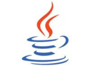




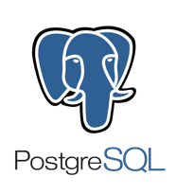






Data Sources supported by DataFrames
built-in
external
JDBC
{ JSON }
and more …
Notes:
C* and memsql have written custom RDDs that use data locality.

Slide 132
Write Less Code: High-Level Operations
Solve common problems concisely with DataFrame functions:
selecting columns and filtering
joining different data sources
aggregation (count, sum, average, etc.)
plotting results (e.g., with Pandas)

Slide 133

Write Less Code: Compute an Average
private IntWritable one = new IntWritable(1);
private IntWritable output =new IntWritable();
protected void map(LongWritable key,
Text value,
Context context) {
String[] fields = value.split("\t");
output.set(Integer.parseInt(fields[1]));
context.write(one, output);
}
----------------------------------------------------------------------------------
IntWritable one = new IntWritable(1)
DoubleWritable average = new DoubleWritable();
protected void reduce(IntWritable key,
Iterable<IntWritable> values,
Context context) {
int sum = 0;
int count = 0;
for (IntWritable value: values) {
sum += value.get();
count++;
}
average.set(sum / (double) count);
context.write(key, average);
}
rdd = sc.textFile(...).map(_.split(" "))
rdd.map { x => (x(0), (x(1).toFloat, 1)) }.
reduceByKey { case ((num1, count1), (num2, count2)) =>
(num1 + num2, count1 + count2)
}.
map { case (key, (num, count)) => (key, num / count) }.
collect()
rdd = sc.textFile(...).map(lambda s: s.split())
rdd.map(lambda x: (x[0], (float(x[1]), 1))).\
reduceByKey(lambda t1, t2: (t1[0] + t2[0], t1[1] + t2[1])).\
map(lambda t: (t[0], t[1][0] / t[1][1])).\
collect()
Notes:
Input file example:
coffee 10
coffee 20
coffee 32
tea 10
tea 5
tea 30

Slide 134

Write Less Code: Compute an Average
Using RDDs
Full API Docs
Scala
Java
Python
R
rdd = sc.textFile(...).map(_.split(" "))
rdd.map { x => (x(0), (x(1).toFloat, 1)) }.
reduceByKey { case ((num1, count1), (num2, count2)) =>
(num1 + num2, count1 + count2)
}.
map { case (key, (num, count)) => (key, num / count) }.
collect()
Using DataFrames
import org.apache.spark.sql.functions._
val df = rdd.map(a => (a(0), a(1))).toDF("key", "value")
df.groupBy("key")
.agg(avg("value"))
.collect()
Notes:
Input file example:
coffee 10
coffee 20
coffee 32
tea 10
tea 5
tea 30

Slide 135

Construct a DataFrame (Scala)
# Construct a DataFrame from a "users" table in Hive.
val df = spark.table("users")
# Construct a DataFrame from a log file in S3.
val df = spark.load("s3n://aBucket/path/to/data.json", "json")
Notes:
The following example shows how to construct DataFrames in Python. A similar API is available in Scala and Java.

Slide 136
Use DataFrames (Scala)
// Load log and users DataFrame from Hive
val log = spark.table("log")
val users = spark.table("users")
// Create a new DataFrame that contains only "young" users
val young = users.filter($"age" < 21)
// Increment everybody's age by 1
young.select($"name", $"age" + 1)
// Count the number of young users by gender
young.groupBy("gender").count()
# Join young users with another DataFrame, logs
young.join(log, log("userId") === young("userId"), "left_outer")
Notes:
Once built, DataFrames provide a domain-specific language for distributed data manipulation. Here is an example of using DataFrames to manipulate the demographic data of a large population of users:

Slide 137
DataFrames and Spark SQL
young.createOrReplaceTempView("young")
spark.sql("SELECT count(*) FROM young")
Notes:
You can also incorporate SQL while working with DataFrames, using Spark SQL. This example counts the number of users in the young DataFrame. NOTE: createOrReplaceTempViewdoes not create a table, temporary or otherwise.

Slide 138
What, exactly, is Spark SQL?
Spark SQL allows you to manipulate distributed data with SQL queries. Currently, two SQL dialects are supported.
If you’re using a Spark SQLContext, the only supported dialect is “sql,” a rich subset of SQL 2003.
If you’re using a HiveContext, the default dialect is "hiveql", corresponding to Hive's SQL dialect. “sql” is also available, but “hiveql” is a richer dialect.

Slide 139
Spark SQL
You issue SQL queries through a SQLContext or HiveContext, using the sql() method.
The sql() method returns a DataFrame.
You can mix DataFrame methods and SQL queries in the same code.
To use SQL, you must either:
query a persisted Hive table, or
make a table alias for a DataFrame, using createOrReplaceTempView()
Notes:
CreateOrReplaceTempView()

Slide 140
Transformations, Actions, Laziness
Like RDDs, DataFrames are lazy. Transformations contribute to the query plan, but they don't execute anything. Actions cause the execution of the query.
Transformation examples
Action examples
filter
select
drop
intersect
join
count
collect
show
head
take
Notes:
Head is non-deterministic, could change between jobs. Just the first partition that materialized returns results.

Slide 141
Transformations, Actions, Laziness
Actions cause the execution of the query.
What, exactly, does “execution of the query” mean? It means:
Spark initiates a distributed read of the data source
The data flows through the transformations (the RDDs resulting from the Catalyst query plan)
The result of the action is pulled back into the driver JVM.

Slide 142
Creating a DataFrame in Scala
Program: including setup; the DataFrame reads are 1 line each
import org.apache.spark.sql.SparkSession
...
val spark = SparkSession.builder .appName("Sample App") .getOrCreate()
val df = spark.read.parquet("/path/to/data.parquet")
val df2 = spark.read.json("/path/to/data.json")

Slide 143
DataFrames Have Schemas
In the previous example, we created DataFrames from Parquet and JSON data.
A Parquet table has a schema (column names and types) that Spark can use. Parquet also allows Spark to be efficient about how it pares down data.
Spark can infer a Schema from a JSON file.

Slide 144
printSchema()
You can have Spark tell you what it thinks the data schema is, by calling the printSchema() method. (This is mostly useful in the shell.)
> df.printSchema()
root |-- firstName: string (nullable = true) |-- lastName: string (nullable = true) |-- gender: string (nullable = true) |-- age: integer (nullable = false)

Slide 145

Schema Inference (Scala)
import sqlContext.implicits._
case class Person(firstName: String,
lastName: String,
gender: String,
age: Int)
val rdd = sc.textFile("people.csv")
val peopleRDD = rdd.map { line =>
val cols = line.split(",")
Person(cols(0), cols(1), cols(2), cols(3).toInt)
}
val df = peopleRDD.toDF
// df: DataFrame = [firstName: string, lastName: string, gender: string, age: int]
Notes:
Notice this is problematic, all columns are treated as strings (including age)
You’d want to be more robust about parsing CSV in real life.
The serializer can’t easily infer the types of the columns if you use a Python class. A namedtuple is preferred.

Slide 146
Schema Inference
We can also force schema inference
without creating our own People type,
by using a fixed-length data structure (such as a tuple)
and supplying the column names to the toDF() method.

Slide 147
Schema Inference (Python)
rdd = sc.textFile("people.csv")
def map_line(line):
columns = line.split(",")[:5]
return Row(*columns)
data_rdd = rdd.map(map_line)
df = data_rdd.toDF("firstName", "lastName", "gender", "age")
If you don’t supply the column names, the API defaults to “_1”, “_2”, etc.
Notes:
You’d want to be more robust about parsing CSV in real life.

Slide 148
Schema Inference (Scala)
val rdd = sc.textFile("people.csv")
val peopleRDD = rdd.map { line =>
val cols = line.split(",")
Row(cols(0), cols(1), cols(2), cols(3).toInt)
}
val df = peopleRDD.toDF("firstName", "lastName",
"gender", "age")
If you don’t supply the column names, the API defaults to “_1”, “_2”, etc.
Notes:
You’d want to be more robust about parsing CSV in real life.

Slide 149
What can I do with a DataFrame?
Once you have a DataFrame, there are a number of operations you can perform.
Let’s look at a few of them.

Slide 150
show()
You can look at the first n elements in a DataFrame with the show() method. If not specified, n defaults to 20.
This method is an action. It:
reads (or re-reads) the input source
executes the RDD DAG across the cluster
pulls the n elements back to the driver JVM
displays those elements in a tabular form

Slide 151
show()
> df.show()
+---------+--------+------+---+
|firstName|lastName|gender|age|
+---------+--------+------+---+
| Erin| Shannon| F| 42|
| Claire| McBride| F| 23|
| Norman|Lockwood| M| 81|
| Miguel| Ruiz| M| 64|
| Rosalita| Ramirez| F| 14|
| Ally| Garcia| F| 39|
| Abigail|Cottrell| F| 75|
| José| Rivera| M| 59|
+---------+--------+------+---+

Slide 152
select()
select() is like a SQL SELECT, allowing you to limit the results to specific columns.
scala> df.select($"firstName", $"age").show(5)
+---------+---+ |firstName|age| +---------+---+ | Erin| 42| | Claire| 23| | Norman| 81| | Miguel| 64| | Rosalita| 14| +---------+---+
Notes:
Talk about the DSL for accessing columns here.
Parquet would be very good with this sort of slicing.

Slide 153
select()
In[1]: df.select(df['first_name'], df['age'], df['age'] > 49).show(5)
+----------+---+----------+
|first_name|age|(age > 49)|
+----------+---+----------+
| Erin| 42| false|
| Claire| 23| false|
| Norman| 81| true|
| Miguel| 64| true|
| Rosalita| 14| false|
+----------+---+----------+

Slide 154
select()
The DSL also allows you create on-the-fly derived columns.
scala> df.select($"firstName", $"age", $"age" > 49, $"age" + 10).show(5)
+---------+---+----------+----------+
|firstName|age|(age > 49)|(age + 10)|
+---------+---+----------+----------+
| Erin| 42| false| 52|
| Claire| 23| false| 33|
| Norman| 81| true| 91|
| Miguel| 64| true| 74|
| Rosalita| 14| false| 24|
+---------+---+----------+----------+
Notes:
We are generating 2 new columns here.

Slide 155
filter()
The filter() method allows you to filter rows out of your results.
scala> df.filter($"age" > 49). select($"first_name", $"age"). show()
+---------+---+ |firstName|age| +---------+---+ | Norman| 81| | Miguel| 64| | Abigail| 75| +---------+---+

Slide 156
filter()
The filter() method allows you to filter rows out of your results.
scala> df.filter($"age" > 49).select($"firstName", $"age").show()
+---------+---+ |firstName|age| +---------+---+ | Norman| 81| | Miguel| 64| | Abigail| 75| +---------+---+
Notes:
This is like a where clause in SQL…
There are 3 dataframes here.

Slide 157
orderBy()
The orderBy() method allows you to sort the results.
scala> df.filter($"age" > 49). select($"firstName", $"age"). orderBy($"age", $"firstName"). show()
+---------+---+ |firstName|age| +---------+---+ | Miguel| 64| | Abigail| 75| | Norman| 81| +---------+---+
Notes:
This sorts first my age, then by name.
(if there were a couple of people aged 75, you could see this better)

Slide 158
orderBy()
It’s easy to reverse the sort order.
scala> df.filter($"age" > 49). select($"firstName", $"age"). orderBy($"age".desc, $"firstName"). show()
+---------+---+ |firstName|age| +---------+---+ | Norman| 81| | Abigail| 75| | Miguel| 64| +---------+---+

Slide 159
as() or alias()
as() or alias() allows you to rename a column.
It’s especially useful with generated columns.
scala> df.select($"firstName", $"age", ($"age" < 30).as("young")).show()
+---------+---+-----+
|firstName|age|young|
+---------+---+-----+
| Erin| 42|false|
| Claire| 23| true|
| Norman| 81|false|
| Miguel| 64|false|
| Rosalita| 14| true|
+---------+---+-----+

Slide 160
as() or alias()
In [7]: df.select(df['first_name'],\
df['age'],\
(df['age'] < 30).alias('young')).show(5)
+----------+---+-----+
|first_name|age|young|
+----------+---+-----+
| Erin| 42|false|
| Claire| 23| true|
| Norman| 81|false|
| Miguel| 64|false|
| Rosalita| 14| true|
+----------+---+-----+
Note: In Python, you must use alias, because as is a keyword.
Notes:
df[‘age’] < 30 is making a derived column.

Slide 161

as()
And, of course, SQL:
spark.sql("SELECT firstName, age, age < 30 AS young FROM names")
+---------+---+-----+
|firstName|age|young|
+---------+---+-----+
| Erin| 42|false|
| Claire| 23| true|
| Norman| 81|false|
| Miguel| 64|false|
| Rosalita| 14| true|
+---------+---+-----+

Slide 162
groupBy()
Often used with count(), groupBy() groups data items by a specific column value.
> df.groupBy("age").count().show()
+---+-----+
|age|count|
+---+-----+
| 39| 1|
| 42| 2|
| 64| 1|
| 75| 1|
| 81| 1|
| 14| 1|
| 23| 2|
+---+-----+
Notes:
WARNING: Don't confuse this count() with the action. This count() is not an action; it's a method on GroupedData. This is highly confusing to users.
groupBy returned “groupedData” not a dataframe. The groupedData can be aggregated as count, sum, min, max, etc. Count returns a dataframe.

Slide 163
groupBy()
And SQL, of course, isn't surprising:
scala> spark.sql("SELECT age, count(age) FROM names GROUP BY age")
+---+-----+
|age|count|
+---+-----+
| 39| 1|
| 42| 2|
| 64| 1|
| 75| 1|
| 81| 1|
| 14| 1|
| 23| 2|
+---+-----+
Notes:
WARNING: Don't confuse this count() with the action. This count() is not an action; it's a method on GroupedData. This is highly confusing to users.

Slide 164
Joins
Let’s assume we have a second file, a JSON file with records like this:
[
{
"firstName": "Erin",
"lastName": "Shannon",
"medium": "oil on canvas"
},
{
"firstName": "Norman",
"lastName": "Lockwood",
"medium": "metal (sculpture)"
},
…
]

Slide 165
Joins
We can load that into a second DataFrame and join it with our first one.
scala> val df2 = spark.read.json("artists.json")
# Schema inferred as DataFrame[firstName: string, lastName: string, medium: string]
scala> df.join(df2, (df("first_name") === df2("firstName") & (df("last_name" === df2("lastName")).show()
+----------+---------+------+---+---------+--------+-----------------+
|first_name|last_name|gender|age|firstName|lastName| medium|
+----------+---------+------+---+---------+--------+-----------------+
| Norman| Lockwood| M| 81| Norman|Lockwood|metal (sculpture)|
| Erin| Shannon| F| 42| Erin| Shannon| oil on canvas|
| Rosalita| Ramirez| F| 14| Rosalita| Ramirez| charcoal|
| Miguel| Ruiz| M| 64| Miguel| Ruiz| oil on canvas|
+----------+---------+------+---+---------+--------+-----------------+
Notes:
It joined both datasets and showed all columns of both..

Slide 166
Joins
Let’s make that a little more readable by only selecting some of the columns.
scala> val df3 = df.join(
df2, (df("first_name") === df2("firstName") & (df("last_name") === df2("lastName") )
scala> df3.select("first_name", "last_name", "age", "medium").show()
+----------+---------+---+-----------------+
|first_name|last_name|age| medium|
+----------+---------+---+-----------------+
| Norman| Lockwood| 81|metal (sculpture)|
| Erin| Shannon| 42| oil on canvas|
| Rosalita| Ramirez| 14| charcoal|
| Miguel| Ruiz| 64| oil on canvas|
+----------+---------+---+-----------------+

Slide 167
User Defined Functions
Let's invent a function that doesn't exist. We'll create a function to extract the month field from a timestamp-typed column and return the month name.
scala> df.select(monthName($("time")))
console>:23: error: not found: value monthName
df.select(monthName($("time"))).show() ^

Slide 168
User Defined Functions
Let's fix that problem.
scala> val monthName = spark.udf.register("monthName", (t: Timestamp) => {
import java.text.SimpleDateFormat
import java.util.Date
val fmt = new SimpleDateFormat("MMM")
fmt.format(new Date(t.getTime))
})
monthName: org.apache.spark.sql.UserDefinedFunction = UserDefinedFunction(<function1>,StringType,List())
scala> df.select(monthName($"time")).show(5)
+---------+ |UDF(time)| +---------+ | Oct| | Oct| +---------+

Slide 169
Writing DataFrames
You can write DataFrames out, as well. When doing ETL, this is a very common requirement.
In most cases, if you can read a data format, you can write that data format, as well.
If you're writing to a text file format (e.g., JSON), you'll typically get multiple output files.

Slide 170
DataFrames can be significantly faster than RDDs. And they perform the same, regardless of language.
Notes:
The above chart compares the runtime performance of running group-by-aggregation on 10 million integer pairs on a single machine (source code). Since both Scala and Python DataFrame operations are compiled into JVM bytecode for execution, there is little difference between the two languages, and both outperform the vanilla Python RDD variant by a factor of 5 and Scala RDD variant by a factor of 2.
Source code: https://gist.github.com/rxin/c1592c133e4bccf515dd

Slide 171
Plan Optimization & Execution
Represented internally as a “logical plan”
Execution is lazy, allowing it to be optimized by Catalyst

Slide 172
Plan Optimization & Execution
Analysis
Logical
Optimization
Physical
Planning
Code
Generation
SQL AST
Unresolved Logical Plan
Logical Plan
Optimized Logical Plan
Physical Plans
Selected Physical Plan
RDDs
Cost Model
DataFrame
Catalog
DataFrames and SQL share the same optimization/execution pipeline
Notes:
Unlike the eagerly evaluated data frames in R and Python, DataFrames in Spark have their execution automatically optimized by a query optimizer. Before any computation on a DataFrame starts, the Catalyst optimizer compiles the operations that were used to build the DataFrame into a physical plan for execution. Because the optimizer understands the semantics of operations and structure of the data, it can make intelligent decisions to speed up computation.
At a high level, there are two kinds of optimizations.
First, Catalyst applies logical optimizations such as predicate pushdown. The optimizer can push filter predicates down into the data source, enabling the physical execution to skip irrelevant data. In the case of Parquet files, entire blocks can be skipped and comparisons on strings can be turned into cheaper integer comparisons via dictionary encoding. In the case of relational databases, predicates are pushed down into the external databases to reduce the amount of data traffic.
Second, Catalyst compiles operations into physical plans for execution and generatesJVM bytecode for those plans that is often more optimized than hand-written code. For example, it can choose intelligently between broadcast joins and shuffle joins to reduce network traffic. It can also perform lower level optimizations such as eliminating expensive object allocations and reducing virtual function calls. As a result, we expect performance improvements for existing Spark programs when they migrate to DataFrames.

Slide 173
Plan Optimization & Execution
joined = users.join(events, users.id == events.uid)
filtered = joined.filter(events.date >= "2015-01-01")
logical plan
filter
join
scan
(users)
scan
(events)

Slide 174
Plan Optimization & Execution
joined = users.join(events, users.id == events.uid)
filtered = joined.filter(events.date >= "2015-01-01")
logical plan
filter
this join is expensive →
join
scan
(users)
scan
(events)

Slide 175
Plan Optimization & Execution
joined = users.join(events, users.id == events.uid)
filtered = joined.filter(events.date >= "2015-01-01")
logical plan
optimized plan
filter
join
join
scan
(users)
filter
scan
(users)
scan
(events)
scan
(events)

Slide 176
Plan Optimization & Execution
joined = users.join(events, users.id == events.uid)
filtered = joined.filter(events.date >= "2015-01-01")
logical plan
optimized plan
optimized plan
with intelligent data sources
filter
join
join
join
scan
(users)
filter
scan
(users)
scan
(events)
scan
(events)
scan
(users)
filter scan
(events)
filter done by data source (e.g., RDBMS via JDBC)

Slide 177
Explain
You can dump the query plan to standard output, so you can get an idea of how Spark will execute your query.
scala> val df3 = df.join(df2, (df("first_name") === df2("firstName")) & (df("last_name") === df2("lastName"))
scala> df3.explain()
ShuffledHashJoin [last_name#18], [lastName#36], BuildRight
Exchange (HashPartitioning 200)
PhysicalRDD [first_name#17,last_name#18,gender#19,age#20L], MapPartitionsRDD[41] at applySchemaToPythonRDD at NativeMethodAccessorImpl.java:-2
Exchange (HashPartitioning 200)
PhysicalRDD [firstName#35,lastName#36,medium#37], MapPartitionsRDD[118] at executedPlan at NativeMethodAccessorImpl.java:-2

Slide 178
Explain
Pass true to get a more detailed query plan.
scala> df.join(df2, lower(df("firstName")) === lower(df2("firstName"))).explain(true)
== Parsed Logical Plan ==
Join Inner, Some((Lower(firstName#1) = Lower(firstName#13)))
Relation[birthDate#0,firstName#1,gender#2,lastName#3,middleName#4,salary#5L,ssn#6] org.apache.spark.sql.json.JSONRelation@7cbb370e
Relation[firstName#13,lastName#14,medium#15] org.apache.spark.sql.json.JSONRelation@e5203d2c
== Analyzed Logical Plan ==
birthDate: string, firstName: string, gender: string, lastName: string, middleName: string, salary: bigint, ssn: string, firstName: string, lastName: string, medium: string
Join Inner, Some((Lower(firstName#1) = Lower(firstName#13)))
Relation[birthDate#0,firstName#1,gender#2,lastName#3,middleName#4,salary#5L,ssn#6] org.apache.spark.sql.json.JSONRelation@7cbb370e
Relation[firstName#13,lastName#14,medium#15] org.apache.spark.sql.json.JSONRelation@e5203d2c
== Optimized Logical Plan ==
Join Inner, Some((Lower(firstName#1) = Lower(firstName#13)))
Relation[birthDate#0,firstName#1,gender#2,lastName#3,middleName#4,salary#5L,ssn#6] org.apache.spark.sql.json.JSONRelation@7cbb370e
Relation[firstName#13,lastName#14,medium#15] org.apache.spark.sql.json.JSONRelation@e5203d2c
== Physical Plan ==
ShuffledHashJoin [Lower(firstName#1)], [Lower(firstName#13)], BuildRight
Exchange (HashPartitioning 200)
PhysicalRDD [birthDate#0,firstName#1,gender#2,lastName#3,middleName#4,salary#5L,ssn#6], MapPartitionsRDD[40] at explain at <console>:25
Exchange (HashPartitioning 200)
PhysicalRDD [firstName#13,lastName#14,medium#15], MapPartitionsRDD[43] at explain at <console>:25
Code Generation: false
== RDD ==

Slide 179
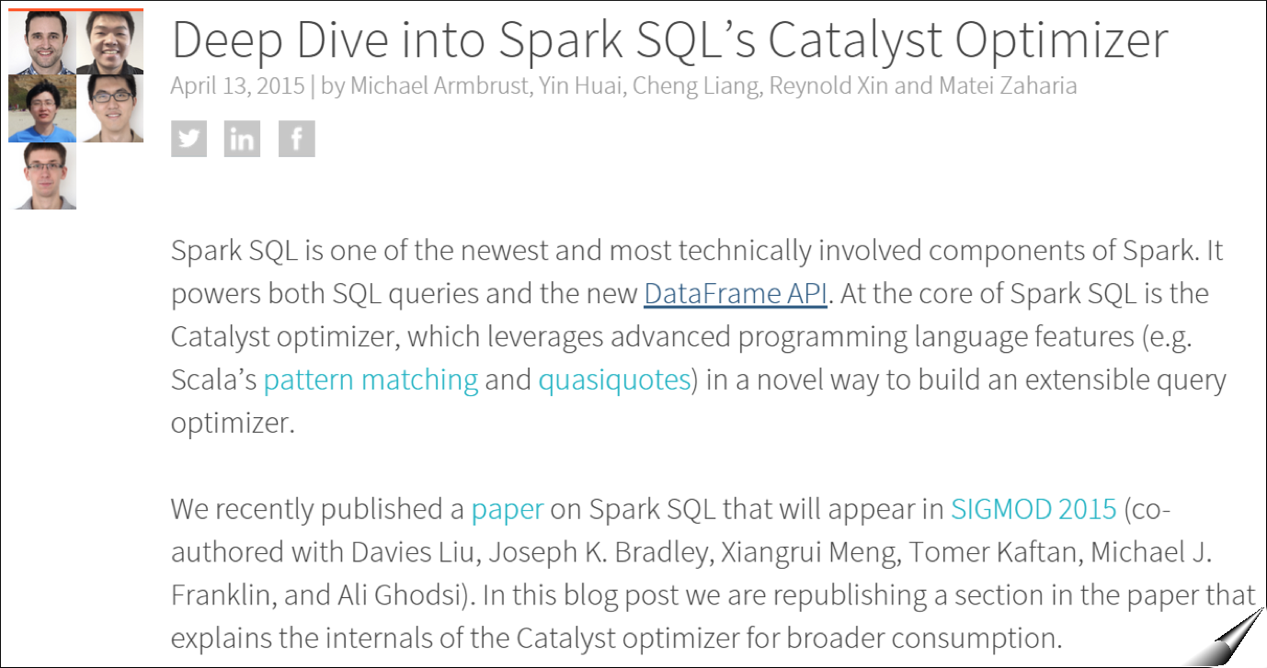
Catalyst Internals
https://databricks.com/blog/2015/04/13/deep-dive-into-spark-sqls-catalyst-optimizer.html
Notes:
https://databricks.com/blog/2015/04/13/deep-dive-into-spark-sqls-catalyst-optimizer.html

Slide 180
DataFrame limitations
Catalyst does not automatically repartition DataFrames optimally
During a DF shuffle, Spark SQL will just use
spark.sql.shuffle.partitions
to determine the number of partitions in the downstream RDD
All SQL configurations can be changed
via sqlContext.setConf(key, value)
or in Databricks: "%sql SET key=val"
Notes:
LAB HERE.
LAB IS NEXT. DECIDE IF WE GOT TIME.

Slide 181
Streaming
(RDD Based)

Slide 182

Spark Streaming
Scalable
High-throughput
Fault-tolerant
TCP socket
Kafka
HDFS / S3
Flume
Cassandra
HBase
HDFS
Dashboards
S3
Streaming
Databases
Kinesis
Complex algorithms can be expressed using:
Spark transformations: map(), reduce(), join()…
MLlib + GraphX
SQL
Twitter
Notes:
Spark Streaming is an extension of the core Spark API that enables scalable, high-throughput, fault-tolerant stream processing of live data streams.
Data can be ingested from many sources like Kafka, Flume, Twitter, ZeroMQ, Kinesis or TCP sockets can be processed using complex algorithms expressed with high-level functions like map,reduce, join and window.
Finally, processed data can be pushed out to filesystems, databases, and live dashboards.
In fact, you can apply Spark’s machine learning (3 work right now, Streaming K-Means, Logistic regression, linear regression) and graph processing algorithms on data streams.

Slide 183


Batch and Real-time
Batch
Real-time
Streaming
One unified API

Slide 184


Use Cases
Streaming
Page views
Kafka for buffering
Spark for processing

Slide 185



Use Cases
Smart meter readings
Join 2 live data sources
Streaming
Live weather data
Notes:
An electric company can join 100s of thousands of live data points from the electric grid with live weather data and apply predictive machine learning algorithms to try to predict that a snow storm might be starting in Denver and to start devoting personnel and resources there to fix grid problems.

Slide 186
Data Model
Input data streams
Batches of processed data
Streaming
R
R
CORE
R
Batches every X seconds

Slide 187

DStream (Discretized Stream)
Batch interval = 5 seconds
T = 5
Input
DStream
Part. #1
Part. #2
Part. #3
RDD @ T=5
One RDD is created every 5 seconds
Notes:
TO-DO: animate the second one after first.
Spark is built on the idea of RDDs. Likewise, Spark Streaming is build on the idea of Dstreams.
A DStream is a sequence of data arriving over time.
Internally, each DStream is represented as a sequence of RDDs arriving at each time step.
Each RDD in a DStream contains data from a certain interval, as shown in the following figure.

Slide 188
DStream (Discretized Stream)
Batch interval = 5 seconds
T = 5
T = 10
Input
DStream
Part. #1
Part. #2
Part. #3
Part. #1
Part. #2
Part. #3
RDD @ T=5
RDD @ T=10
One RDD is created every 5 seconds
Notes:
TO-DO: animate the second one after first.
Spark is built on the idea of RDDs. Likewise, Spark Streaming is build on the idea of Dstreams.
A DStream is a sequence of data arriving over time.
Internally, each DStream is represented as a sequence of RDDs arriving at each time step.
Each RDD in a DStream contains data from a certain interval, as shown in the following figure.

Slide 189


Transforming DStreams
5 sec
10 sec
15 sec
Block #1
Block #2
Block #3
Notes:
Ask TD: Is that first conversion from Blocks to Partitions called a transformation?
Any operation applied on a DStream translates to operations on the underlying RDDs.
These underlying RDD transformations are computed by the Spark engine. The DStream operations hide most of these details and provide the developer with higher-level API for convenience.

Slide 190
Transforming DStreams
5 sec
10 sec
15 sec
Block #1
Block #2
Block #3
linesDStream
Part. #1
Part. #2
Part. #3
Notes:
Ask TD: Is that first conversion from Blocks to Partitions called a transformation?
Any operation applied on a DStream translates to operations on the underlying RDDs.
These underlying RDD transformations are computed by the Spark engine. The DStream operations hide most of these details and provide the developer with higher-level API for convenience.

Slide 191
Transforming DStreams
5 sec
10 sec
15 sec
Block #1
Block #2
Block #3
linesDStream
Part. #1
Part. #2
Part. #3
flatMap()
wordsDStream
Part. #1
Part. #2
Part. #3
Notes:
Ask TD: Is that first conversion from Blocks to Partitions called a transformation?
Any operation applied on a DStream translates to operations on the underlying RDDs.
These underlying RDD transformations are computed by the Spark engine. The DStream operations hide most of these details and provide the developer with higher-level API for convenience.

Slide 192


Scala Example
import org.apache.spark.streaming._
val sc = SparkContext(...)
// Create a StreamingContext with a 1-second batch size from a SparkConf
val ssc = new StreamingContext(sc, Seconds(1))
// Create DStream using data received after connecting to localhost:7777
val linesStream = ssc.socketTextStream("localhost", 7777)
// Filter our DStream for lines with "error"
val errorLinesStream = linesStream.filter {_ contains "error"}
// Print out the lines with errors
errorLinesStream.pprint()
// Start our streaming context and wait for it to "finish"
ssc.start()
ssc.awaitTermination()
linesStream
errorLinesStream
Notes:
In code, it’s all Stream types… but in the background… in execution layer, it is making RDDs.
First, we import StreamingContext, which is the main entry point for all streaming functionality. We create a local StreamingContext with two execution threads, and batch interval of 5 seconds.
Using this context, we can create a DStream that represents streaming data from a TCP source, specified as hostname (e.g. localhost) and port (e.g. 9999).
This lines DStream represents the stream of data that will be received from the data server. Each record in this DStream is a line of text. Next, we want to split the lines by space into words.
flatMap is a one-to-many DStream operation that creates a new DStream by generating multiple new records from each record in the source DStream. In this case, each line will be split into multiple words and the stream of words is represented as the words DStream. Next, we want to count these words.
The words DStream is further mapped (one-to-one transformation) to a DStream of (word, 1) pairs, which is then reduced to get the frequency of words in each batch of data. Finally, wordCounts.pprint() will print a few of the counts generated every second.
Start receiving data and processing it using streamingContext.start()
Wait for the processing to be stopped (manually or due to any error) usingstreamingContext.awaitTermination()
The processing can be manually stopped using streamingContext.stop().

Slide 193

Example
Terminal
#1
Terminal
#2
$ nc –l –p 7777
all is good
there was an error
good good
error 4 happened
all good now
$ spark-submit --class com.examples.Scala.StreamingLog \
$ASSEMBLY_JAR local[4]
. . .
--------------------------
Time: 2015-05-26 15:25:21
--------------------------
there was an error
--------------------------
Time: 2015-05-26 15:25:22
--------------------------
error 4 happened

Slide 194
Structured Streaming (DataFrame based)

Slide 195
The simplest way to perform streaming analytics is not having to reason about streaming at all

Slide 196
Dataset, DataFrame
Static, bounded table
Streaming, unbounded table
Single API !

Slide 197
Structured Streaming
High-level streaming API built on Spark SQL engine
Runs the same computation as batch queries in Datasets/DataFrames
Event time, windowing, sessions, sources & sinks
End-to-end exactly once semantics
Unifies streaming, interactive and batch queries
Aggregate data in a stream, then serve using JDBC
Add, remove, change queries at runtime
Build and apply ML models

Slide 198
Pain points with DStreams
Processing with event-time, dealing with late data
DStream API exposes batch time, hard to incorporate event-time
Interoperate streaming with batch AND interactive
RDD/DStream has similar API, but still requires translation
Hard to interoperate with DataFrames and Datasets
Reasoning about end-to-end guarantees
Requires carefully constructing sinks that handle failures correctly
Data consistency in the storage while being updated

Slide 199
Advantages over DStreams
Processing with event-time, dealing with late data
Exactly same API for batch, streaming, and interactive
End-to-end exactly-once guarantees from the system
Performance through SQL optimizations
Logical plan optimizations, Tungsten, Codegen, etc.
Faster state management for stateful stream processing

Slide 200
Model
Trigger: every 1 sec
1
2
3
Time
Input: data from source as an
append-only table
Trigger: how frequently to check
input for new data
Query: operations on input
usual map/filter/reduce
new window, session ops
Input
data up to 1
data up to 2
data up
to 3
Query
Notes:
Although we only process new input, all input can be stored as an append only table (DF).

Slide 201
Model
Trigger: every 1 sec
1
2
3
Time
Result: final operated table
updated every trigger interval
Output: what part of result to write
to data sink after every trigger
Complete output: Write full result table every time
Input
data up to 1
data up to 2
data up
to 3
Query
Result
output for data up to 1
output for data up to 2
output for data up to 3
Output
complete
output
Notes:
We will output whatever we processed.

Slide 202
Model
Trigger: every 1 sec
1
2
3
Time
Result: final operated table
updated every trigger interval
Output: what part of result to write
to data sink after every trigger
Complete output: Write full result table every time
Delta output: Write only the rows that changed
in result from previous batch
Append output: Write only new rows
Input
data up to 1
data up to 2
data up
to 3
Query
Result
output for data up to 1
output for data up to 2
output for data up to 3
Output
delta
output
Notes:
Incrementaly append output to new spark DF

Slide 203
Batch ETL with DataFrame
input = ctxt.read
.format("json")
.load("source-path")
result = input
.select("device", "signal")
.where("signal > 15")
result.write
.format("parquet")
.save("dest-path")
Read from Json file
Select some devices
Write to parquet file

Slide 204
Streaming ETL with DataFrame
input = ctxt.read
.format("json")
.stream("source-path")
result = input
.select("device", "signal")
.where("signal > 15")
result.write
.format("parquet")
.outputMode("append")
.startStream("dest-path")
Read from Json file stream
Select some devices
Write to parquet file stream

Slide 205
Streaming ETL with DataFrame
input = ctxt.read
.format("json")
.stream("source-path")
result = input
.select("device", "signal")
.where("signal > 15")
result.write
.format("parquet")
.outputMode("append")
.startStream("dest-path")
read…stream() creates a streaming DataFrame, does not start any of the computation
write…startStream() defines where & how to output the data and starts the processing
Notes:
Requires output operation (write) to trigger streaming to start.

Slide 206
Machine Learning Overview

Slide 207
Example: Log prioritization
Data: Test logs
Goal: Prioritize logs to investigate
Running test: pyspark/conf.py
Spark assembly has been built with Hive, including Datanucleus jars on classpath
14/12/15 18:36:12 WARN Utils: Your hostname,
-1.1
Running test: pyspark/broadcast.py
Spark assembly has been built with Hive, including Datanucleus jars on classpath
14/12/15 18:36:30 ERROR Aliens attacked the
1.9
Notes:
We will use a log prioritization example. This is an application of machine learning. (not an algo)
Goal, take test logs… and predict a priority.
Priority will tell us which logs we need to investigate further.
Here, see normal test, it worked, don’t need to look at it.
2nd has a higher priority (error)
But you can’t look at every log line, so this is a way to find the important logs

Slide 208
Example: Log prioritization
Data: Test logs
Goal: Prioritize logs to investigate
Instance
Running test: pyspark/conf.py
Spark assembly has been built with Hive, including Datanucleus jars on classpath
14/12/15 18:36:12 WARN Utils: Your hostname,
Label
-1.1
How can we learn?
Choose a model
Get training data
Run a learning algorithm
Notes:
Here, just to define somer terminology
Left: Instance text. The datam
We want to predict the label (the priority here, but it could be many things). It could be spam or not spam for an email. It could be temp for that date.
How can we learn? There’s 3 parts: choose a model, get data, run an algorithm to fit that model on the data.

Slide 209
A model is a function f: x → y
(prediction)
Instance
x
Running test: pyspark/conf.py
Spark assembly has been built with Hive, including Datanucleus jars on classpath
14/12/15 18:36:12 WARN Utils: Your hostname,
y
Label
-1.1
Convert to features,
e.g., word counts
...
Running
test
Spark
aliens
43
67
110
0
Feature vector x
mllib.linalg.Vector
Notes:
Mathematically speaking, a model is a function going from x to y.
X is instance, y is label (priority)
The way you represent this function on a computer is by first taking the instance and converting it to a numerical vector, called a feature vector (like word count)
Here, there’s 43 instances of the word running, 67 of test, etc.
In Mllib, this will be represented by a linalg.Vector. Throughout this talk, I’ll try to put these classes to look for in green just to make it easier ot look up.
There is a class in Mllib that does this (converts words to feature vector), called a feature transformer.
This vector is a object.

Slide 210
A model is a function f: x → y
LinearRegression
Learning
= choosing parameters w
Our model: Parameter vector w
...
w:
0.0
0.1
-0.1
50
...
y
w^{T}x
0.0
+
6.7
+
-11.0
+
0.0
= -1.1
Running
test
Spark
aliens
...
x:
43
67
110
0
Notes:
The model is a function.
One the data is represented as a feature vector, what odes the model look like… mathematically?
This is an example with linear regression, one of the most common ML models.
The model is just another vector called a parameter vector.
Give, this model…The way that you compute a prediction, is a simple vector dot product.
The word running has a corresponding weight in the model vector. Here the weight is zero indicating that the appearance of the word running does not affect log priority. -11 means, it is pushing the priority even lower.
So each of the #s in the middle is the word count times it’s corresponding weight. And then we add them all together, and that’s the prediction (y)
So, learning means choosing these parameters w.

Slide 211
Data for learning
Instance
Running test: pyspark/conf.py
Spark assembly has been built with Hive, including Datanucleus jars on classpath
14/12/15 18:36:12 WARN Utils: Your hostname,
Label
-1.1
LabeledPoint(features: Vector, label: Double)

Slide 212
Data for learning
Instances
Labels
Running test: pyspark/conf.py
Spark assembly has been built with Hive, including Datanucleus jars on classpath
14/12/15 18:36:12 WARN Utils: Your hostname,
-1.1
Dataset
RDD[LabeledPoint]
Running test: pyspark/conf.py
Spark assembly has been built with Hive, including Datanucleus jars on classpath
14/12/15 18:36:12 WARN Utils: Your hostname,
2.3
Running test: pyspark/conf.py
Spark assembly has been built with Hive, including Datanucleus jars on classpath
14/12/15 18:36:12 WARN Utils: Your hostname,
0.1
...

Slide 213
Workflow: training + testing
New API
(“Pipelines”)
Dataframe
Running test: pyspark/conf.py
Spark assembly has been built with Hive, including Datanucleus jars on classpath
14/12/15 18:36:12 WARN Utils: Your hostname,
-1.1
Estimator
ML model
Running test: pyspark/conf.py
Spark assembly has been built with Hive, including Datanucleus jars on classpath
14/12/15 18:36:12 WARN Utils: Your hostname,
2.3
ML algorithm
Linear
Regression
Model
Training
Running test: pyspark/conf.py
Spark assembly has been built with Hive, including Datanucleus jars on classpath
14/12/15 18:36:12 WARN Utils: Your hostname,
0.1
Linear
Regression
Running test: pyspark/conf.py
Spark assembly has been built with Hive, including Datanucleus jars on classpath
14/12/15 18:36:12 WARN Utils: Your hostname,
-1.1
…
Transformer
New logs
Predicted priorities
ML model
Running test: pyspark/conf.py
Spark assembly has been built with Hive, including Datanucleus jars on classpath
14/12/15 18:36:12 WARN Utils: Your hostname,
-1.1
Testing
Running test: pyspark/conf.py
Spark assembly has been built with Hive, including Datanucleus jars on classpath
14/12/15 18:36:12 WARN Utils: Your hostname,
2.3
Running test: pyspark/conf.py
Spark assembly has been built with Hive, including Datanucleus jars on classpath
14/12/15 18:36:12 WARN Utils: Your hostname,
0.1
…
Notes:
The word pipeline refers to workflow and basically you pipe data through a series of transformations.

Slide 214
Background: MLlib & our goals
Status: Algorithmic coverage & functionality
Roadmap: Ongoing & future work

Slide 215
Algorithm Coverage
Classification
Regression
Recommendation
Clustering
Frequent Itemsets
Feature extraction & selection
Statistics
Linear algebra
Model import/export
Pipelines
DataFrames
Cross validation

Slide 216
Architecture

Slide 217





Ways to Run Spark
Local
Static Allocation
Standalone Scheduler
YARN
Dynamic Allocation
Mesos
Notes:
Static vs. Dynamic doesn’t refer to RDD partitioning here…
In cluster mode Spark depends on a cluster manager to launch executors and, in certain cases, to launch the driver. The cluster manager is a pluggable component in Spark.
Each one of these resource managers has different pros and cons. One nice thing about running Spark in YARN, for example, is that you can dynamically resize the # of Executors in the application. This feature is not yet possible in Standalone mode.
Static Partitioning: With this approach, each application is given a maximum amount of resources it can use, and holds onto them for its whole duration.
Mesos: In “fine-grained” mode (default), each Spark task runs as a separate Mesos task. This allows multiple instances of Spark (and other frameworks) to share machines at a very fine granularity, where each application gets more or fewer machines as it ramps up and down, but it comes with an additional overhead in launching each task. This mode may be inappropriate for low-latency requirements like interactive queries or serving web requests.
In Standalone and Mesos course-grained, you can control the maximum number of resources Spark will acquire. By default, it will acquire all cores in the cluster (that get offered by Mesos), which only makes sense if you run just one application at a time. You can cap the max # of cores using conf.set("spark.cores.max", "10") (for example).
Standalone mode: By default, applications submitted to the standalone mode cluster will run in FIFO (first-in-first-out) order, and each application will try to use all available nodes. You can limit the number of nodes an application uses by setting the spark.cores.maxconfiguration property in it, or change the default for applications that don’t set this setting through spark.deploy.defaultCores. Finally, in addition to controlling cores, each application’s spark.executor.memory setting controls its memory use.
YARN: The --num-executors option to the Spark YARN client controls how many executors it will allocate on the cluster, while --executor-memory and --executor-cores control the resources per executor.
The “coarse-grained” mode will instead launch only one long-running Spark task on each Mesos machine, and dynamically schedule its own “mini-tasks” within it. The benefit is much lower startup overhead, but at the cost of reserving the Mesos resources for the complete duration of the application

Slide 218
Local Mode

Slide 219


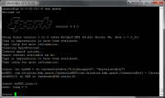
Local Mode
> ./bin/spark-shell --master local[12]
CPUs:
3 options: local, local[N], local[*]
JVM: Ex + Driver
> ./bin/spark-submit --name "MyFirstApp"
--master local[12] --py-files app.zip main.py
RDD, P1
Task
Task
RDD, P1
Task
Task
RDD, P2
Task
Task
spark = SparkSession.builder \
.master("local[2]") \
.appName(”pysparkApp") \
.config("spark.executor.memory", "1g") \
.getOrCreate()
RDD, P2
Task
Task
RDD, P3
Task
Task
Task
Task
Internal Threads
Worker Machine
Disk
Notes:
Local – run spark with one worker thread
Local[N] – run spark with N worker threads
Local[*] – run Spark with as many worker threads as logical cores on your machine
Note, that in local mode a shuffle is not costly! Not good for real performance testing.
Spark can efficiently support tasks as short as 200 ms
- - - -
There are a lot of internal threads (I think shuffle servers alone have 8 threads?), but most of them are just idle and don't do much so I wouldn't worry about the overhead.
You can launch a spark shell on a single node and then run jstack to see what all the threads are doing.
- - -Ask Reynold: In local mode, can students still change the % of memory allocated to tasks vs shuffle vs user code? A) Yes, same thing.

Slide 220
Standalone Mode

Slide 221




Spark Standalone
different spark-env.sh
SPARK_WORKER_CORES
W
W
W
W
Ex
Ex
Ex
Ex
RDD,P1
T
T
RDD,P4
T
T
RDD,P5
T
T
RDD,P7
T
T
RDD,P2
T
T
RDD,P6
T
T
RDD,P3
T
T
RDD,P8
T
T
RDD,P1
T
T
RDD,P1
T
T
RDD,P2
T
T
RDD,P2
T
T
T
T
Internal Threads
T
T
Internal Threads
Internal Threads
Internal Threads
Driver
Spark Master
OS Disk
SSD
SSD
OS Disk
SSD
SSD
OS Disk
SSD
SSD
OS Disk
SSD
SSD
SSD
SSD
SSD
SSD
SSD
SSD
SSD
SSD
> ./bin/spark-submit --name “SecondApp"
--master spark://host4:port1
--class www.example.com.Main myApp.jar
vs.
spark-env.sh
SPARK_LOCAL_DIRS
Notes:
Mention how much RAM to give each JVM
Mention that OOMs can happen in the driver or execyutor
There will be 3 masters and the workers… when they start up, they ask ZK where the active master is.
How to separate RDD caches on disk from shuffle data? A) It is not possible right now
Spark_local_dirs: (SSDs) Directory to use for "scratch" space in Spark, including map output files and RDDs that get stored on disk. This should be on a fast, local disk in your system. It can also be a comma-separated list of multiple directories on different disks. NOTE: In Spark 1.0 and later this will be overriden by SPARK_LOCAL_DIRS (Standalone, Mesos) or LOCAL_DIRS (YARN) environment variables set by the cluster manager
- -
On the 2nd machine, we have SPARK_WORKER_CORES set to 10, instead of 6 like all the other machines.
Note, there’s no way to tell a worker that has SPARK_WORKER_CORES set to 15 to just launch Executors with only 10 cores. However, you can start an entire Spark application and say that you only want ‘x’ cores and then some workers will launch Executors, but other workers will not. This could lead to a bit of unbalanced cluster.
- - - -
ZooKeeper:
Utilizing ZooKeeper to provide leader election and some state storage, you can launch multiple Masters in your cluster connected to the same ZooKeeper instance. One will be elected “leader” and the others will remain in standby mode. If the current leader dies, another Master will be elected, recover the old Master’s state, and then resume scheduling. The entire recovery process (from the time the first leader goes down) should take between 1 and 2 minutes. Note that this delay only affects scheduling new applications – applications that were already running during Master failover are unaffected.
After you have a ZooKeeper cluster set up, enabling high availability is straightforward. Simply start multiple Master processes on different nodes with the same ZooKeeper configuration (ZooKeeper URL and directory). Masters can be added and removed at any time.
In order to schedule new applications or add Workers to the cluster, they need to know the IP address of the current leader. This can be accomplished by simply passing in a list of Masters where you used to pass in a single one. For example, you might start your SparkContext pointing to spark://host1:port1,host2:port2. This would cause your SparkContext to try registering with both Masters – if host1 goes down, this configuration would still be correct as we’d find the new leader, host2.
There’s an important distinction to be made between “registering with a Master” and normal operation. When starting up, an application or Worker needs to be able to find and register with the current lead Master. Once it successfully registers, though, it is “in the system” (i.e., stored in ZooKeeper). If failover occurs, the new leader will contact all previously registered applications and Workers to inform them of the change in leadership, so they need not even have known of the existence of the new Master at startup.
Due to this property, new Masters can be created at any time, and the only thing you need to worry about is that new applications and Workers can find it to register with in case it becomes the leader. Once registered, you’re taken care of.

Slide 222
Spark Standalone
different spark-env.sh
SPARK_WORKER_CORES
W
W
W
W
Ex
Ex
Ex
Ex
RDD,P1
T
T
RDD,P4
T
T
RDD,P5
T
T
RDD,P7
T
T
RDD,P2
T
T
RDD,P6
T
T
RDD,P3
T
T
RDD,P8
T
T
RDD,P1
T
T
RDD,P1
T
T
RDD,P2
T
T
RDD,P2
T
T
T
T
Internal Threads
T
T
Internal Threads
Internal Threads
Internal Threads
I’m HA via ZooKeeper
More Masters can be added live
Driver
Spark Master
Spark Master
Spark Master
OS Disk
SSD
SSD
OS Disk
SSD
SSD
OS Disk
SSD
SSD
OS Disk
SSD
SSD
SSD
SSD
SSD
SSD
SSD
SSD
SSD
SSD
> ./bin/spark-submit --name “SecondApp"
--master spark://host1:port1,host2:port2
--class www.example.com.Main myApp.jar
vs.
spark-env.sh
SPARK_LOCAL_DIRS
Notes:
Note: In the DataStax distribution, the Spark Master is HA via the C* system table.
There will be 3 masters and the workers… when they start up, they ask ZK where the active master is.
How to separate RDD caches on disk from shuffle data? A) It is not possible right now
Spark_local_dirs: (SSDs) Directory to use for "scratch" space in Spark, including map output files and RDDs that get stored on disk. This should be on a fast, local disk in your system. It can also be a comma-separated list of multiple directories on different disks. NOTE: In Spark 1.0 and later this will be overriden by SPARK_LOCAL_DIRS (Standalone, Mesos) or LOCAL_DIRS (YARN) environment variables set by the cluster manager
- -
On the 2nd machine, we have SPARK_WORKER_CORES set to 10, instead of 6 like all the other machines.
Note, there’s no way to tell a worker that has SPARK_WORKER_CORES set to 15 to just launch Executors with only 10 cores. However, you can start an entire Spark application and say that you only want ‘x’ cores and then some workers will launch Executors, but other workers will not. This could lead to a bit of unbalanced cluster.
- - - -
ZooKeeper:
Utilizing ZooKeeper to provide leader election and some state storage, you can launch multiple Masters in your cluster connected to the same ZooKeeper instance. One will be elected “leader” and the others will remain in standby mode. If the current leader dies, another Master will be elected, recover the old Master’s state, and then resume scheduling. The entire recovery process (from the time the first leader goes down) should take between 1 and 2 minutes. Note that this delay only affects scheduling new applications – applications that were already running during Master failover are unaffected.
After you have a ZooKeeper cluster set up, enabling high availability is straightforward. Simply start multiple Master processes on different nodes with the same ZooKeeper configuration (ZooKeeper URL and directory). Masters can be added and removed at any time.
In order to schedule new applications or add Workers to the cluster, they need to know the IP address of the current leader. This can be accomplished by simply passing in a list of Masters where you used to pass in a single one. For example, you might start your SparkContext pointing to spark://host1:port1,host2:port2. This would cause your SparkContext to try registering with both Masters – if host1 goes down, this configuration would still be correct as we’d find the new leader, host2.
There’s an important distinction to be made between “registering with a Master” and normal operation. When starting up, an application or Worker needs to be able to find and register with the current lead Master. Once it successfully registers, though, it is “in the system” (i.e., stored in ZooKeeper). If failover occurs, the new leader will contact all previously registered applications and Workers to inform them of the change in leadership, so they need not even have known of the existence of the new Master at startup.
Due to this property, new Masters can be created at any time, and the only thing you need to worry about is that new applications and Workers can find it to register with in case it becomes the leader. Once registered, you’re taken care of.

Slide 223
Spark Standalone (multiple apps)
W
W
W
W
Ex
Ex
Ex
Ex
Ex
Ex
Ex
Ex
Driver
Driver
Spark Master
OS Disk
SSD
OS Disk
SSD
OS Disk
SSD
OS Disk
SSD

Slide 224
Spark Standalone (single app)
W
W
W
W
W
W
W
W
Ex
Ex
Ex
Ex
Ex
Ex
Ex
Ex
Driver
Spark Master
OS Disk
SSD
OS Disk
SSD
OS Disk
SSD
OS Disk
SSD
conf/spark-env.sh
SPARK_WORKER_INSTANCES: [default: 1] # of worker instances to run on each machine
SPARK_WORKER_CORES: [default: ALL] # of cores to allow Spark applications to use on the machine
SPARK_WORKER_MEMORY: [default: TOTAL RAM – 1 GB] Total memory to allow Spark applications to use on the machine
SPARK_DAEMON_MEMORY: [default: 512 MB] Memory to allocate to the Spark master and worker daemons themselves
Notes:
You can configure the cluster by setting environment variables in conf/spark-env.sh. Create this file by starting with theconf/spark-env.sh.template, and copy it to all your worker machines for the settings to take effect.
Regarding SPARK_WORKER_INSTANCES:
You can make this more than 1 if you have very large machines and would like multiple Spark worker processes. If you do set this, make sure to also set SPARK_WORKER_CORES explicitly to limit the cores per worker, or else each worker will try to use all the cores.
About SPARK_WORKER_MEMORY:
…note that each application's individual memory is configured using its spark.executor.memory property.

Slide 225
Standalone Settings
Apps submitted will run in FIFO mode by default
spark.cores.max: maximum amount of CPU cores to request for the application from across the cluster
spark.executor.memory: Memory for each executor
Notes:
You cannot say how many executors you want in Standalone mode…

Slide 226
YARN Mode

Slide 227
YARN Benefits
Allows for multiple data processing engines against HDFS or HBase
Dynamically allocates cluster resources and improves utilization over static MR-v
Better scalability in the future (>5,000 node clusters)
Can run multiple Executors on each node for a single Spark App w/ just one NodeManager
Solid Kerberos integration
Allow applications to request specific nodes for scheduling tasks

Slide 228
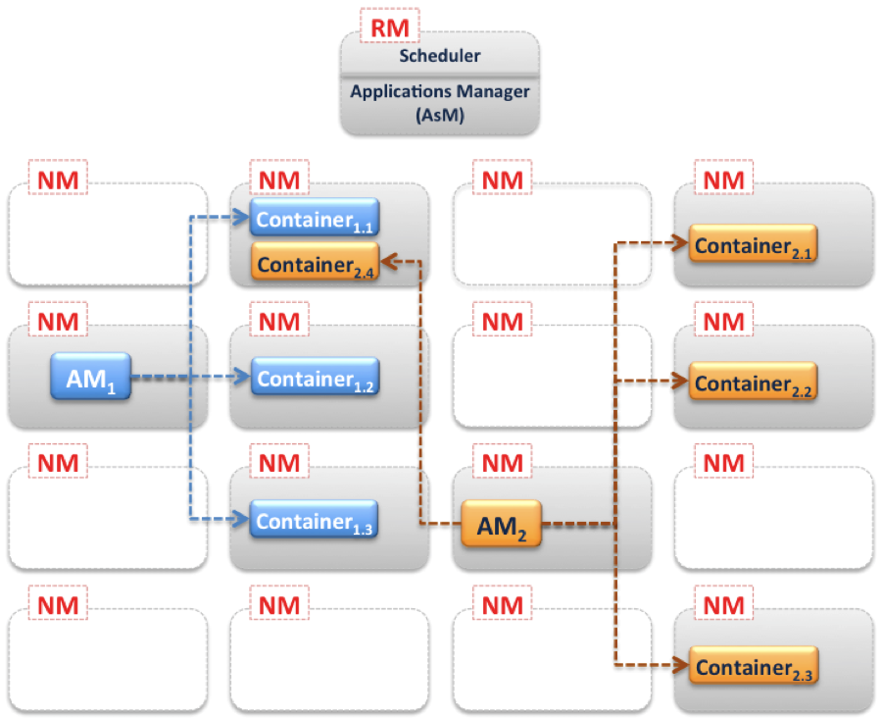
YARN
Source: Cloudera Blog

Slide 229
YARN Settings
http://spark.apache.org/docs/latest/running-on-yarn.html

Slide 230
Spark YARN
Resource
Manager
1
Client #1
2
3
4
5
8
NodeManager
NodeManager
NodeManager
6
6
App Master
Container
Container
7
7
Notes:
The NodeManagers are heartbeating with the Resource Manager and always sharing live resources information.
1) A client program submits the application, including the necessary specifications to launch the application-specific ApplicationMaster itself.
2) The ResourceManager assumes the responsibility to negotiate a specified container in which to start the ApplicationMaster and then launches the ApplicationMaster. Per Andrew: Technically the RM negotiates with the NM to launch a generic container, within which the AppMaster code is instantiated.
3) The ApplicationMaster, on boot-up, registers with the ResourceManager – the registration allows the client program to query the ResourceManager for details, which allow it to directly communicate with its own ApplicationMaster.
4+5) During normal operation the ApplicationMaster negotiates appropriate resource containers via the resource-request protocol.
6) On successful container allocations, the ApplicationMaster launches the container by providing the container launch specification to the NodeManager. The launch specification, typically, includes the necessary information to allow the container to communicate with the ApplicationMaster itself.
7) The application code executing within the container then provides necessary information (progress, status etc.) to its ApplicationMaster via an application-specific protocol.
8) During the application execution, the client that submitted the program communicates directly with the ApplicationMaster to get status, progress updates etc. via an application-specific protocol.
9) Once the application is complete, and all necessary work has been finished, the ApplicationMaster deregisters with the ResourceManager and shuts down, allowing its own container to be repurposed.

Slide 231
Spark YARN
Client #1
Resource
Manager
I’m HA via ZooKeeper
Scheduler
Client #2
Apps Master
NodeManager
NodeManager
NodeManager
App Master
App Master
Container
Container
Container
Container
Notes:
Application: This may be a single job, a sequence of jobs, a long-running service issuing new commands as needed or an interactive exploration session.
Spark Driver: The Spark driver is the process running the spark context (which represents the application session). This driver is responsible for converting the application to a directed graph of individual steps to execute on the cluster. There is one driver per application.
Spark Application Master: The Spark Application Master is responsible for negotiating resource requests made by the driver with YARN and finding a suitable set of hosts/containers in which to run the Spark applications. There is one Application Master per application.
Spark Executor: A single JVM instance on a node that serves a single Spark application. An executor runs multiple tasks over its lifetime, and multiple tasks concurrently. A node may have several Spark executors and there are many nodes running Spark Executors for each client application.
Spark Task: A Spark Task represents a unit of work on a partition of a distributed dataset.

Slide 232
Spark YARN (client mode)
Client #1
Resource
Manager
Driver
NodeManager
NodeManager
NodeManager
Container
App Master
Container
Executor
Executor
RDD
T
RDD
T
Notes:
In client mode (the default), the driver runs on the machine where you executed spark-submit , as part of the spark-submit command.
In yarn-client mode, the driver runs in the client process, and the application master is only used for requesting resources from YARN.
This means that you can directly see the output of your driver program, or send input
to it (e.g. for an interactive shell), but it requires that the machine where you submitted from has fast connectivity to the workers and stays available for the duration of your application. In contrast, in cluster mode, the driver is launched within the standalone cluster, as another process on one of the worker nodes, and then it connects back to request executors. This makes spark-submit more “fire-and-forget”, in that you can close your laptop while the application is running.

Slide 233
Spark YARN (cluster mode)
Resource
Manager
Does not support Spark Shells
Client #1
NodeManager
NodeManager
NodeManager
Container
App Master
Container
Executor
Executor
RDD
T
RDD
T
Container
Driver
Executor
RDD
T
Notes:
When running Spark on YARN, each Spark executor runs as a YARN container. Where MapReduce schedules a container and fires up a JVM for each task, Spark hosts multiple tasks within the same container. This approach enables several orders of magnitude faster task startup time.
Broadly, yarn-cluster mode makes sense for production jobs, while yarn-client mode makes sense for interactive and debugging uses where you want to see your application’s output immediately.
In yarn-cluster mode, the driver runs in the Application Master. This means that the same process is responsible for both driving the application and requesting resources from YARN, and this process runs inside a YARN container. The client that starts the app doesn’t need to stick around for its entire lifetime.
Understanding the difference requires an understanding of YARN’s Application Master concept. In YARN, each application instance has an Application Master process, which is the first container started for that application. The application is responsible for requesting resources from the ResourceManager, and, when allocated them, telling NodeManagers to start containers on its behalf. Application Masters obviate the need for an active client — the process starting the application can go away and coordination continues from a process managed by YARN running on the cluster.

Slide 234
YARN Settings
--num-executors: controls how many executors will be allocated
--executor-memory: RAM for each executor
--executor-cores: CPU cores for each executor
Dynamic Allocation:
spark.dynamicAllocation.enabled
spark.dynamicAllocation.minExecutors
spark.dynamicAllocation.maxExecutors
https://github.com/apache/spark/blob/master/core/src/main/scala/org/apache/spark/ExecutorAllocationManager.scala
Notes:
In Mesos and Standalone mode, Spark will greedily acquire as many cores and executors as are offered by the scheduler. However, both Mesos and Stand‐alone mode support setting spark.cores.max to limit the total number of cores across
all executors for an application.

Slide 235
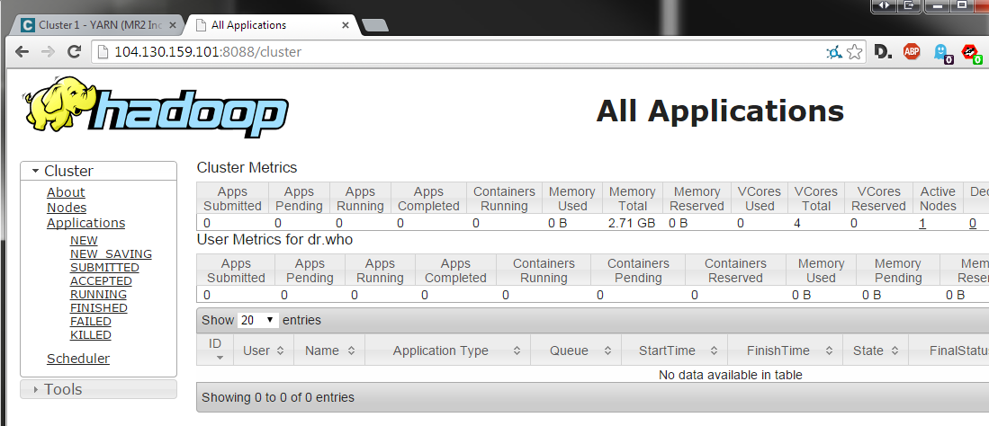
YARN Resource Manager UI
No apps running
http://<ip address>:8088

Slide 236
Starting in “client” mode
[ec2-user@ip-10-0-72-36 ~]$ spark-submit
--class org.apache.spark.examples.SparkPi
--deploy-mode client
--master yarn
/opt/cloudera/parcels/CDH-5.2.1-1.cdh5.2.1.p0.12/jars/spark-examples-1.1.0-cdh5.2.1-hadoop2.5.0-cdh5.2.1.jar
10
Notes:
Note that in client mode, the output from the Spark app is sent directly back to the cmd-line.

Slide 237
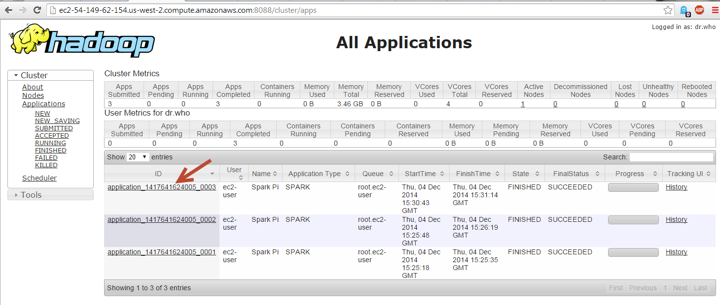
YARN Resource Manager UI
App running in client mode
Notes:
Let’s click on an app to see the details…

Slide 238
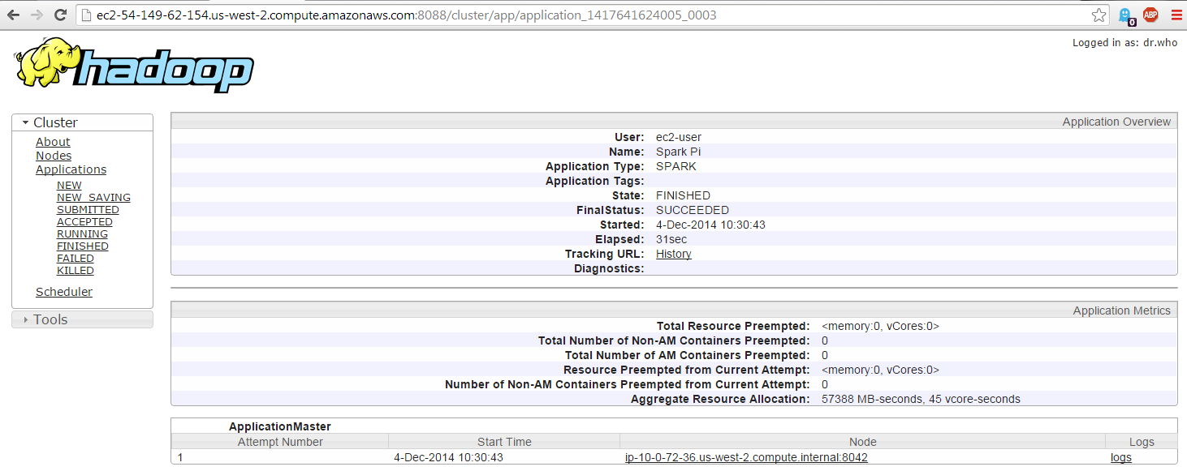
YARN Resource Manager UI
App running in client mode

Slide 239
Starting in “cluster” mode
[ec2-user@ip-10-0-72-36 ~]$ spark-submit
--class org.apache.spark.examples.SparkPi
--deploy-mode cluster
--master yarn
/opt/cloudera/parcels/CDH-5.2.1-1.cdh5.2.1.p0.12/jars/spark-examples-1.1.0-cdh5.2.1-hadoop2.5.0-cdh5.2.1.jar
10
Notes:
Notice that this time, the output is not shown on the cmd line. The output will be printed to the stdout log file for the application.

Slide 240
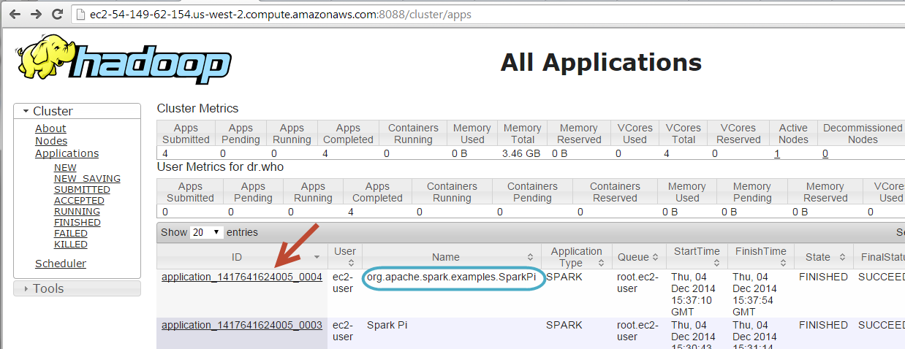
YARN Resource Manager UI
App running in cluster mode

Slide 241
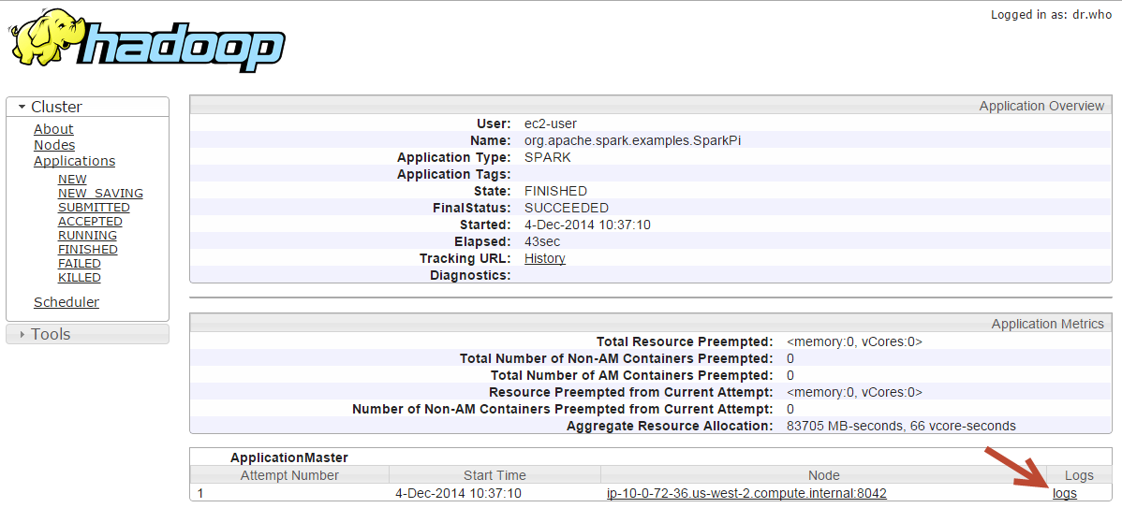
YARN Resource Manager UI
App running in cluster mode

Slide 242
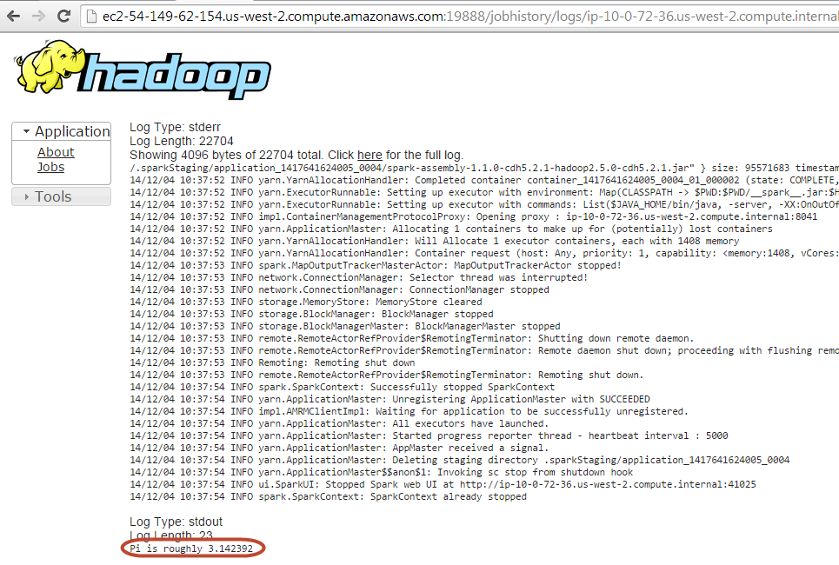
YARN Resource Manager UI
App running in cluster mode

Slide 243
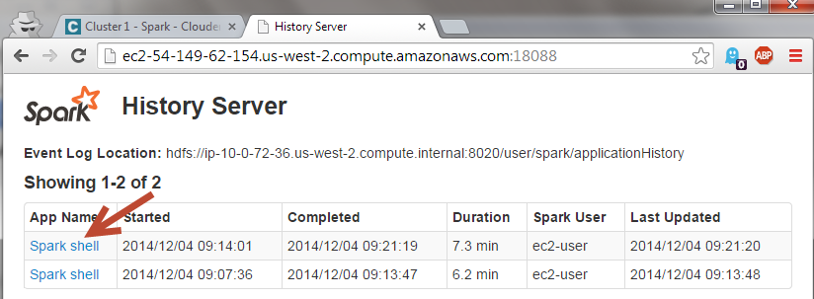
History Server
Notes:
History Server is another Spark JVM that by defaults takes 512 MB of RAM.
Spark’s Standalone Mode cluster manager also has its own web UI. If an application has logged events over the course of its lifetime, then the Standalone master’s web UI will automatically re-render the application’s UI after the application has finished.
If Spark is run on Mesos or YARN, it is still possible to reconstruct the UI of a finished application through Spark’s history server, provided that the application’s event logs exist. You can start the history server by executing:
./sbin/start-history-server.sh

Slide 244
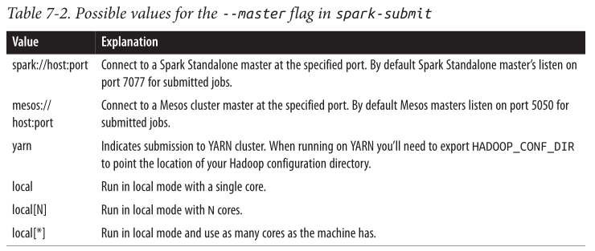

Deploying an App to the Cluster
spark-submit provides a uniform interface for submitting jobs across all cluster managers
bin/spark-submit --master spark://host:7077
--executor-memory 10g
my_script.py
Source: Learning Spark

Slide 245
Summary
To summarize the concepts in this section, let’s walk through the exact steps that occur when you run a Spark application on a cluster.
The user submits an application using spark-submit.
spark-submit launches the driver program and invokes the main method specified by the user.
The driver program contacts the cluster manager to ask for resources to launch executors.
The cluster manager launches executors on behalf of the driver program.
The driver process runs through the user application. Based on the RDD actions and transformations in the program, it sends work to executors in the form of tasks.
Tasks are run on executor processes to compute and save results.
Source: Learning Spark

Slide 246
Dynamic Resource Allocation
Each Spark application scales the number of executors up and down based on workload
If executors are idle, remove them
If we need more executors, request them

Slide 247
Execution Model In
Job 1
Task 1
Task 7
Task 2
Task 4
Task 8
Task 3
Task 5
Task 9
Executor 1
Executor 2
Executor 3
In Spark, each executor is long-running and runs many small tasks
Notes:
Spark = granular pipelined tasks

Slide 248

Execution Model is Different
Hadoop MapReduce
Reduce Task 1
Map Task 2
Reduce Task 2
Container 4
Container 2
Container 5
In MapReduce, each container is short-lived and runs one large task
Notes:
MR = heaviy Map or Reduce tasks

Slide 249
Static Resource Allocation
Resource
(CPU / Mem)
Allocated
Used
Stragglers
Stragglers
Time
New job
New job
Notes:
Click for straglers (tasks that ran slower) and new job

Slide 250
Static Resource Allocation
Resource
(CPU / Mem)
Allocated
Used
Time
More resources allocated than used

Slide 251
Dynamic Resource Allocation
Resource
(CPU / Mem)
Allocated
Used
Time
More efficient utilization of cluster resources
Notes:
Spark is fast because it reuses cluster resources
Spark holds onto resources for a long time
Dynamic allocation allows you to benefit from the former without suffering the latter

Slide 252
Dynamic Allocation Use Cases
Long-running ETL jobs
e.g. Parsing JSON into Parquet in S3
Interactive applications / server
e.g. Spark shell, Ooyala job server
Any application with large shuffles

Slide 253
External Shuffle Service
Must turn this on for dynamic allocation in YARN
Worker JVM serves files
Node Manager serves files
Notes:
External shuffle service.
If you want to use dynamic allocation in YARN, you have to turn this on also.
The Executors will still write out the files after the map runs.
But what if an Executor dies or gets terminated?
You need another process to serve the shuffle files to the Reducers.
In Standalone Mode, Worker JVM is used to serve the files. In YARN, the NodeManager JVM is used (via an auxiliary service)
To enable this service in Standalone mode, set spark.shuffle.service.enabled to true. In YARN, this external shuffle service is implemented in org.apache.spark.yarn.network.YarnShuffleService that runs in each NodeManager in your cluster.

Slide 254
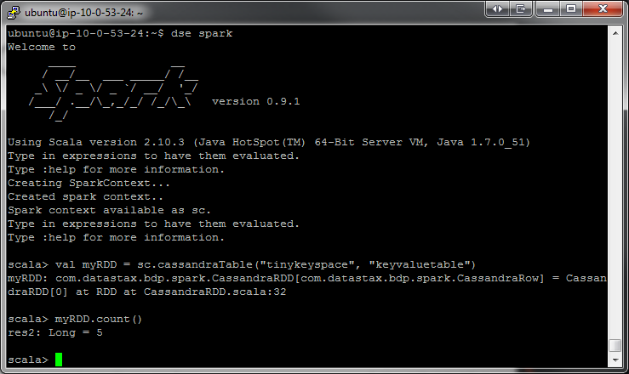
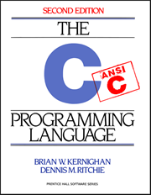
PySpark at a Glance
Write Spark jobs in Python
Run interactive jobs in the shell
Supports C extensions

Slide 255
PySpark to Java API
41 files
8,100 loc
6,300 comments
Spark Core Engine
(Scala)
PySpark
Java API
Local
Standalone Scheduler
YARN
Mesos
Notes:
Built on top of the Java API. It’s a very thin layer that sits on top of Scala and Java Spark.
It provides a way to get data in and out of python and it reuses a lot of the Spark Scala functionality.

Slide 256
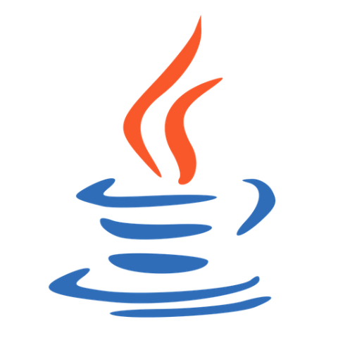

PySpark Architecture
daemon.py
RDD
Pipe
F(x)
RDD
Spark Context
Controller
Py4j
Spark Context
F(x)
Socket
MLlib, SQL, shuffle
Executor JVM
F(x)
Driver JVM
daemon.py
RDD
Pipe
F(x)
Local Disk
MLlib, SQL, shuffle
F(x)
Executor JVM
RDD
Driver Machine
Worker Machine
Notes:
TO-DO: Ask josh about UDFs… running in JVM< or Python PID
Py4J enables Python programs running in a Python interpreter to dynamically access Java objects in a Java Virtual Machine. Essentially, you just call Java methods from your python code as if they were python methods.
These are executor JVMs where num_cores = 2
In the Executor JVM, Pyrolite is used to unpickle the data or to pickle it. “This library allows your Java or .NET program to interface very easily with the Python world. It uses the Pyro protocol to call methods on remote objects. (See https://github.com/irmen/Pyro4). Pyrolite contains and uses a feature complete pickle protocol implementation to exchange data with Pyro/Python. “
Why does the local disk get used on the driver machine? Py4J is very inefficient for transferring large data b/c it uses a text based protocol.. It has to encode in base 64 so really slow. A collect or broadcast may be huge, so Py4j writes one file to the local FS. The final unpickling happens in the Python process on the Driver Machine.
Python functions and closures (with dependencies) are serialized using PiCloud’s CloudPickle module
You could also use Py4J. There is an example on the frontpage and lots of documentation, but essentially, you just call Java methods from your python code as if they were python methods:
You first write a java program where you create a class and run that java program in a JVM. Then you write a Python program that can access that java object via a network socket.
Here is what happens behind the scenes.
On my local machine, I have the Spark Context object… top level entry point for Spark.. Used to create RDDs. SC runs in the Python process.
When a SC is made, behind the scenes it creates a Java Spark context, running on top of regular Spark. Py4J is used to talk (copy data) between a JVM and python using reflection so you can call a java method just as if it was a native python method. It’s pretty cool.
So the python Spark Context is controlling the Java Spark Context. A local file system is also used for communication through multiple files for doing things like collecting results.
The integration with Py4J and Python is fine for like control point stuff, but you don’t want to transfer a whole lot of data through it because reflection is just too expensive.
When you submit a job to the cluster, your job (the Python transformations and stuff) gets mapped down to just a few transformations on this special Python RDD object. Behind the scenes when these objects are shipped to the Spark executor, they actually spin up a bunch of actual python processes. And the Spark Executors communicate with the Python code over pipes using a special format to pass the functions that the user is writing.
SO The executor will pipe all the data into the python processes, get all the results back and serialize it and transfer it.
Naturally, there is some serialization involved
there is one Python process per executor thread (we need this due to Python’s GIL so that CPU-bound tasks can benefit from multiple cores). In older versions of PySpark, we’d end up launching a new Python worker process per task. In newer versions (1.2.0+), executors launch Python processes as needed, keep them around in a pool, and terminate them if they’re idle for too long (1 minute by default); see https://github.com/apache/spark/pull/2259 and the followup patches for more details. The actual subprocess architecture is a little bit complicated because we use a separate process for managing the Python worker processes in order to work around some fork() performance issues in the JVM. This may mean that you’ll see up to 5 Python processes on an executor with 4 threads: one Python process per core, plus the daemon.py middle layer; see https://github.com/apache/spark/pull/1680 for some additional context.
Python UDFs are executed in regular Python interpreters, so things like sc.map(lambda x: some_arbitrary_python_code(x)) are run in Python interpreters, not through anything like Jython. Spark SQL and MLlib may actually end up executing code that runs in the JVM for doing heavy number-crunching and I expect that we’ll see more in-JVM execution of certain operations in future versions of Spark.
See also: the (woefully out-of-date) PySpark internals page on the Spark wiki: https://cwiki.apache.org/confluence/display/SPARK/PySpark+Internals. I really ought to update this page to reflect some of these recent developments.

Slide 257
Reading from HDFS
HadoopRDD
MappedRDD
PythonRDD

Slide 258

Choose Your Python Implementation
CPython
(default python)
Spark Context
pypy
JIT, so faster
less memory
CFFI support
Worker Machine
Driver Machine
$ PYSPARK_DRIVER_PYTHON=pypy PYSPARK_PYTHON=pypy ./bin/pyspark
OR
$ PYSPARK_DRIVER_PYTHON=pypy PYSPARK_PYTHON=pypy ./bin/spark-submit wordcount.py
Notes:
CPython is the original Python implementation. It is the implementation you download from Python.org. CPython compiles your python code into bytecode (transparently) and interprets that bytecode in a evaluation loop. So CPython does not translate your Python code to C by itself. It instead runs a interpreter loop. There is a project that does translate Python-ish code to C, and that is called Cython.
Pypy uses just in time compilation (JIT) or dynamic translation, so it runs faster. This means that compilation is done during the execution of the program (at run time) rather than just prior to execution.
- - -
CFFI: C Foreign Function Interface for Python. The goal is to provide a convenient and reliable way to call compiled C code from Python using interface declarations written in C.
- - -
Pypy uses just in time compilation (JIT) or dynamic translation, so it runs faster. This means that compilation is done during the execution of the program (at run time) rather than just prior to execution.
A JIT compiler is a program that turns Java bytecode (instructions that must be interpreted) into instructions that can be sent directly to the processor.
After you've written a Java program, the source language statements are compiled by the Java compiler into bytecode rather than into code that contains instructions that match a particular hardware platform's processor (for example, an Intel Pentium microprocessor or an IBM System/390 processor). The bytecode is platform-independent code that can be sent to any platform and run on that platform.
In the past, most programs written in any language have had to be recompiled, and sometimes, rewritten for each computer platform. One of the biggest advantages of Java is that you only have to write and compile a program once. The Java on any platform will interpret the compiled bytecode into instructions understandable by the particular processor. However, the virtual machine handles one bytecode instruction at a time. Using the Java just-in-time compiler (really a second compiler) at the particular system platform compiles the bytecode into the particular system code (as though the program had been compiled initially on that platform). Once the code has been (re-)compiled by the JIT compiler, it will usually run more quickly in the computer.
- - -
Good explanation of JIT:
A JIT compiler runs after the program has started and compiles the code (usually bytecode or some kind of VM instructions) on the fly (or just-in-time, as it's called) into a form that's usually faster, typically the host CPU's native instruction set. A JIT has access to dynamic runtime information whereas a standard compiler doesn't and can make better optimizations like inlining functions that are used frequently.
This is in contrast to a traditional compiler that compiles all the code to machine language before the program is first run.
To paraphrase, conventional compilers build the whole program as an EXE file BEFORE the first time you run it. For newer style programs, an assembly is generated with pseudocode (p-code). Only AFTER you execute the program on the OS (e.g., by double-clicking on its icon) will the (JIT) compiler kick in and generate machine code (m-code) that the Intel-based processor or whatever will understand.
- - - - -
Research: https://github.com/apache/spark/blob/master/bin/pyspark#L54
https://github.com/apache/spark/pull/2144

Slide 259
Python Benchmarks
The performance speed up will depend on work load (from 20% to 3000%).
Here are some benchmarks:
Job | CPython 2.7 | PyPy 2.3.1 | Speed up
Word Count | 41 s | 15 s | 2.7 x
Sort | 46 s | 44 s | 1.05 x
Stats | 174 s | 3.6 s | 48 x
Here is the code used for benchmark:
rdd = sc.textFile("text")
def wordcount():
rdd.flatMap(lambda x:x.split('/'))\
.map(lambda x:(x,1)).reduceByKey(lambda x,y:x+y).collectAsMap()
def sort():
rdd.sortBy(lambda x:x, 1).count()
def stats():
sc.parallelize(range(1024), 20).flatMap(lambda x: xrange(5024)).stats()
https://github.com/apache/spark/pull/2144

Slide 260
Default Python Worker process size

Slide 261
Lyuben.Todorov@teradata.com

Slide 262
Feedback
www.tensupport.com/surveys

